Slide 1
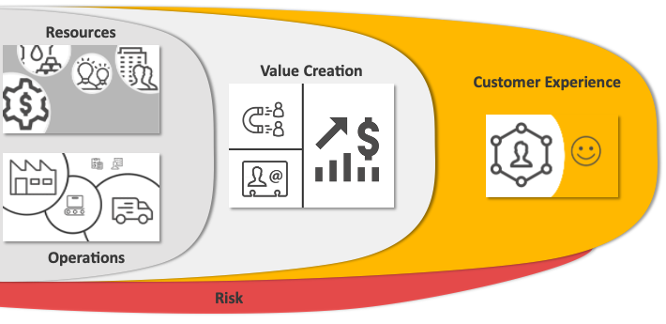

Slide 2



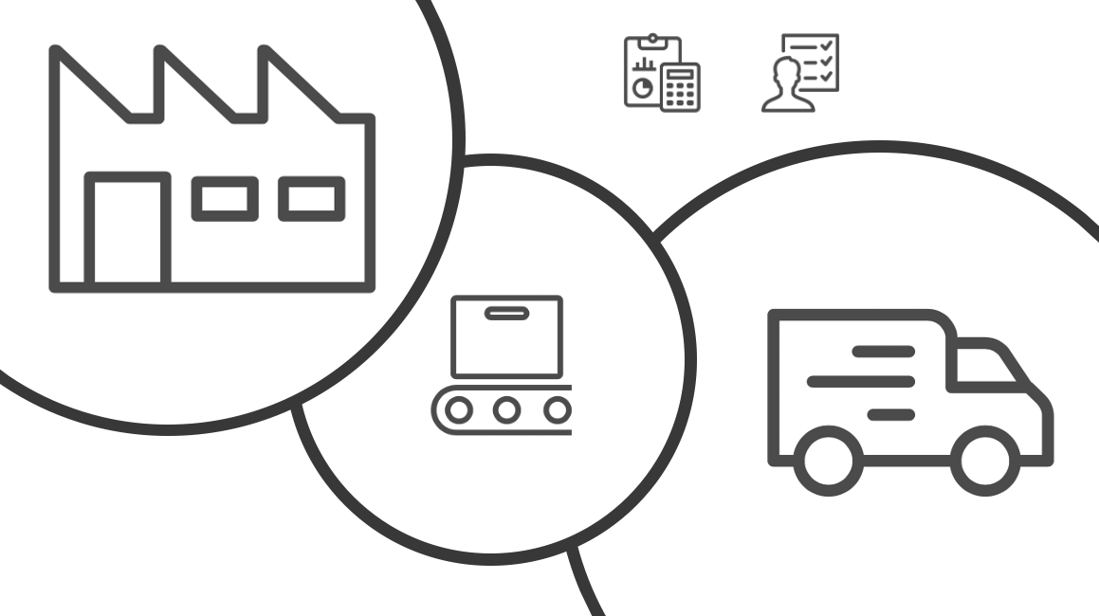
Resources
Value Creation
Customer Experience
Operations
Risk

Slide 3

Audience
Framework Area
Action
Narrator Voice
Presentation Method
☒ Analyst
◻︎ Leader
◻︎ Salesperson
☒ Present in Person
◻︎ Distribute a Document
☒ Executives
◻︎ Colleagues
◻︎ Customers
◻︎ Suppliers
◻︎ Resources
◻︎ Operations
☒ Value Creation
◻︎ Customer Experience
◻︎ Risk
☒ Change
◻︎ Stay the Same
Results
☒ Increase Sales
◻︎ Reduce Costs
◻︎ Increase Productivity
◻︎ Reduce Risk

Slide 4
1. What is the the issue to be addressed in the Business Framework area?
2. What actions should be taken?
3. What are the projected benefits?
4. What are the estimated costs?
5. What is the timeline?
6. Where are we today?
7. How did we get to where we are today?
8. Why do we care?

Slide 5
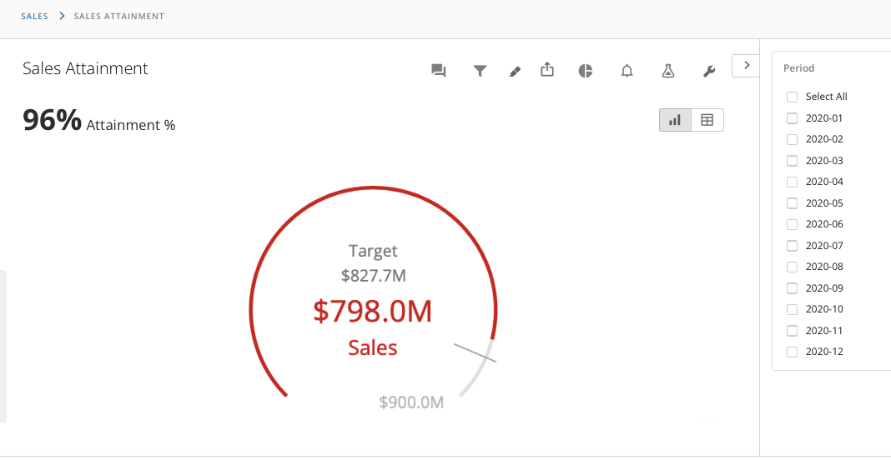

Slide 6
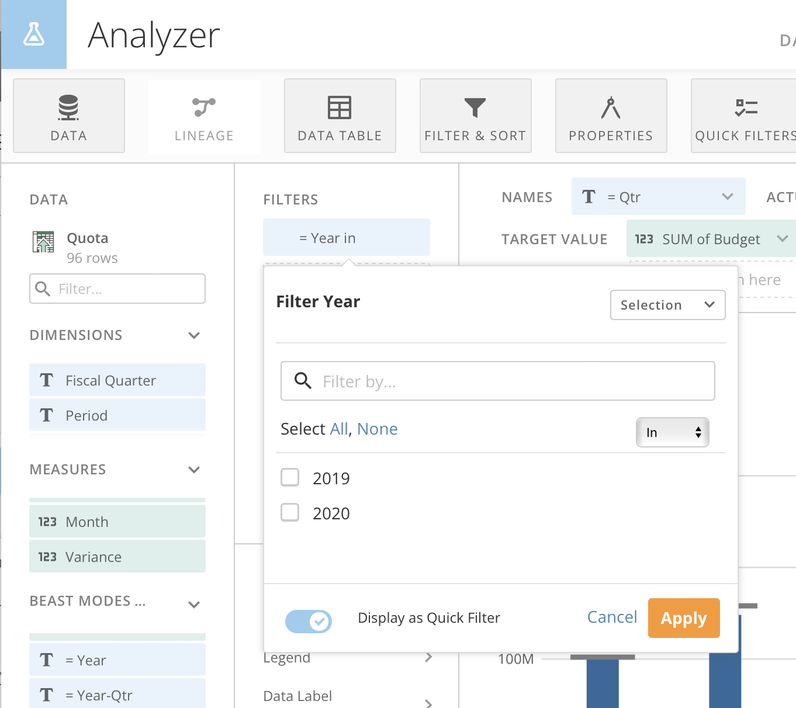

Slide 7
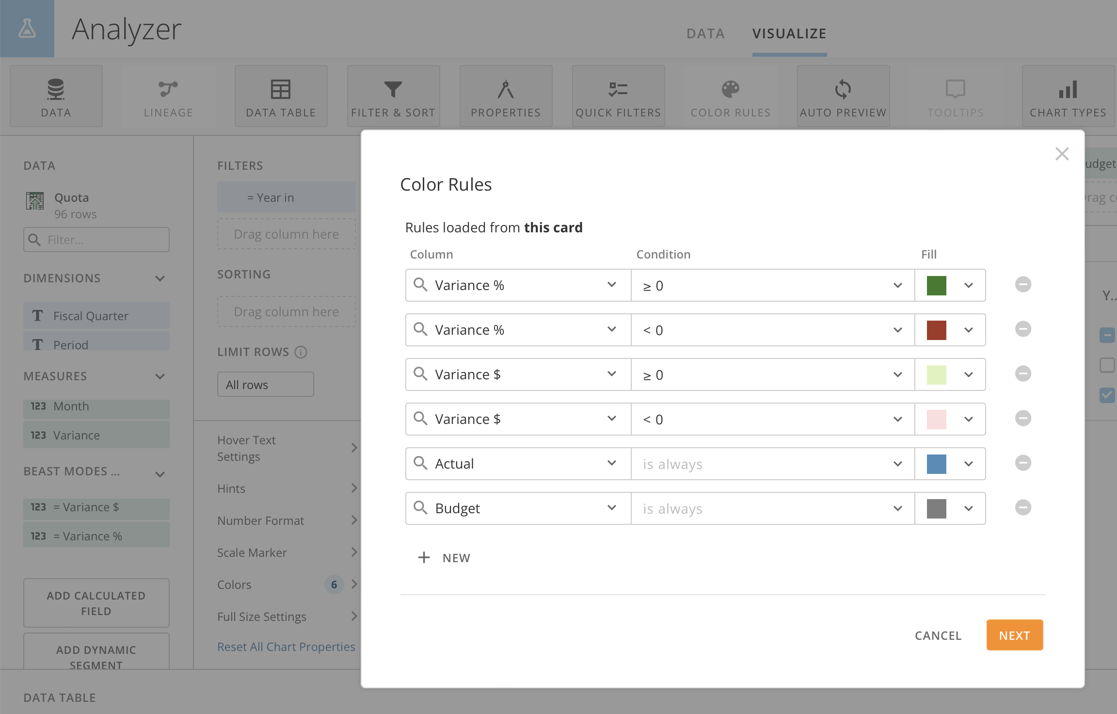

Slide 8
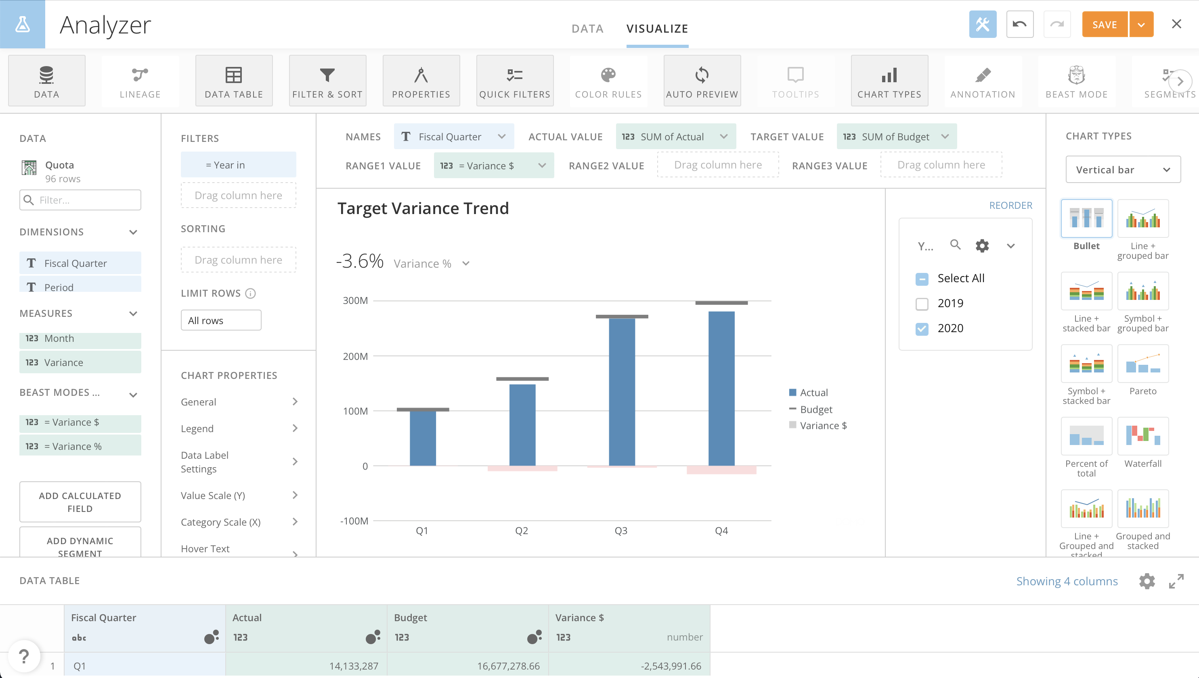

Slide 9
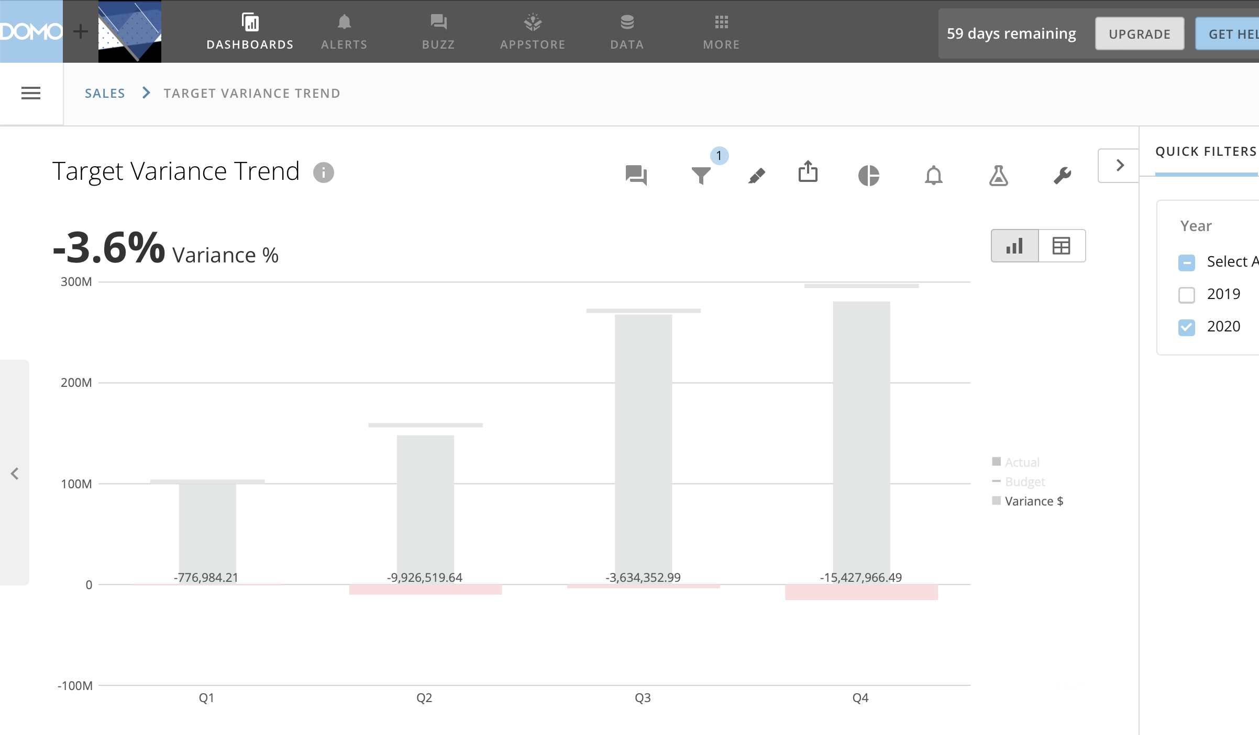

Slide 10
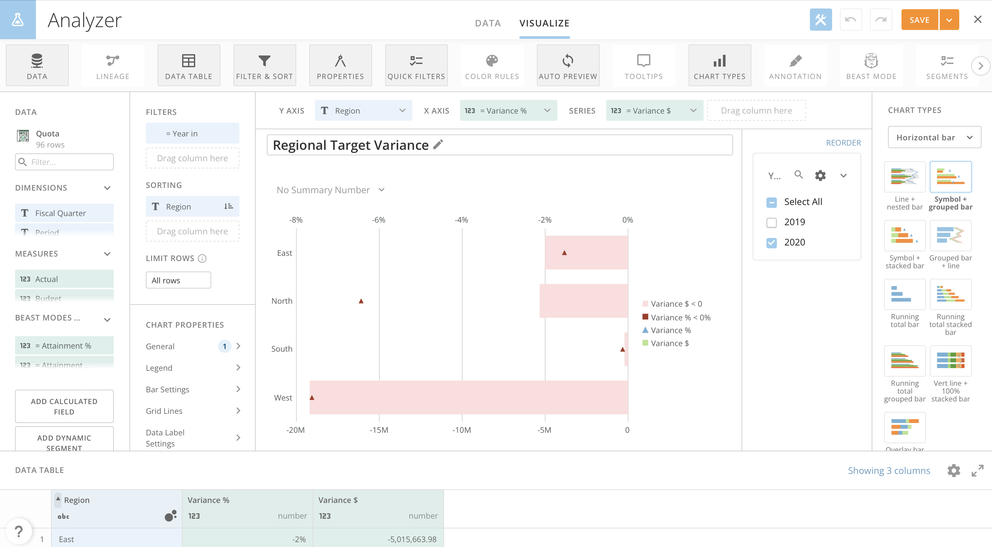

Slide 11
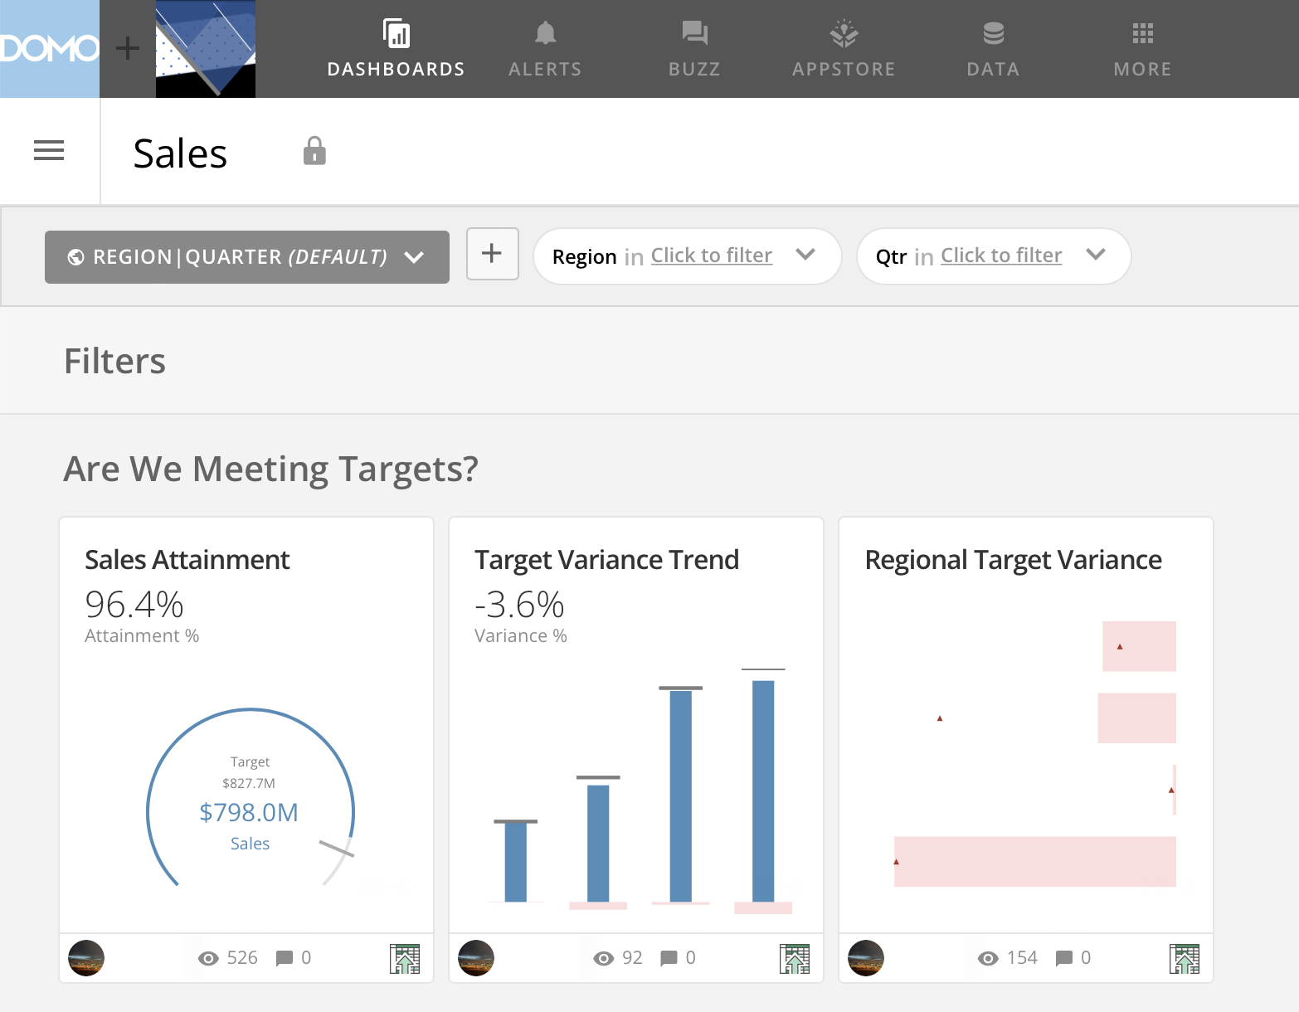

Slide 12
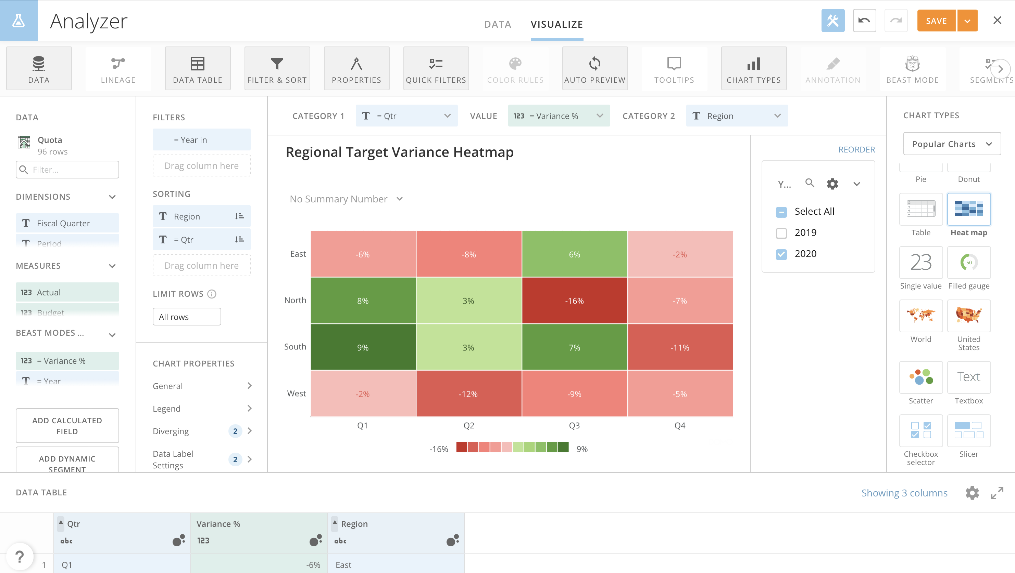

Slide 13
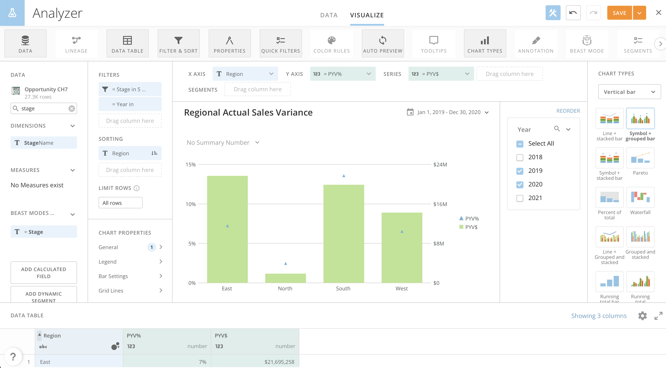

Slide 14
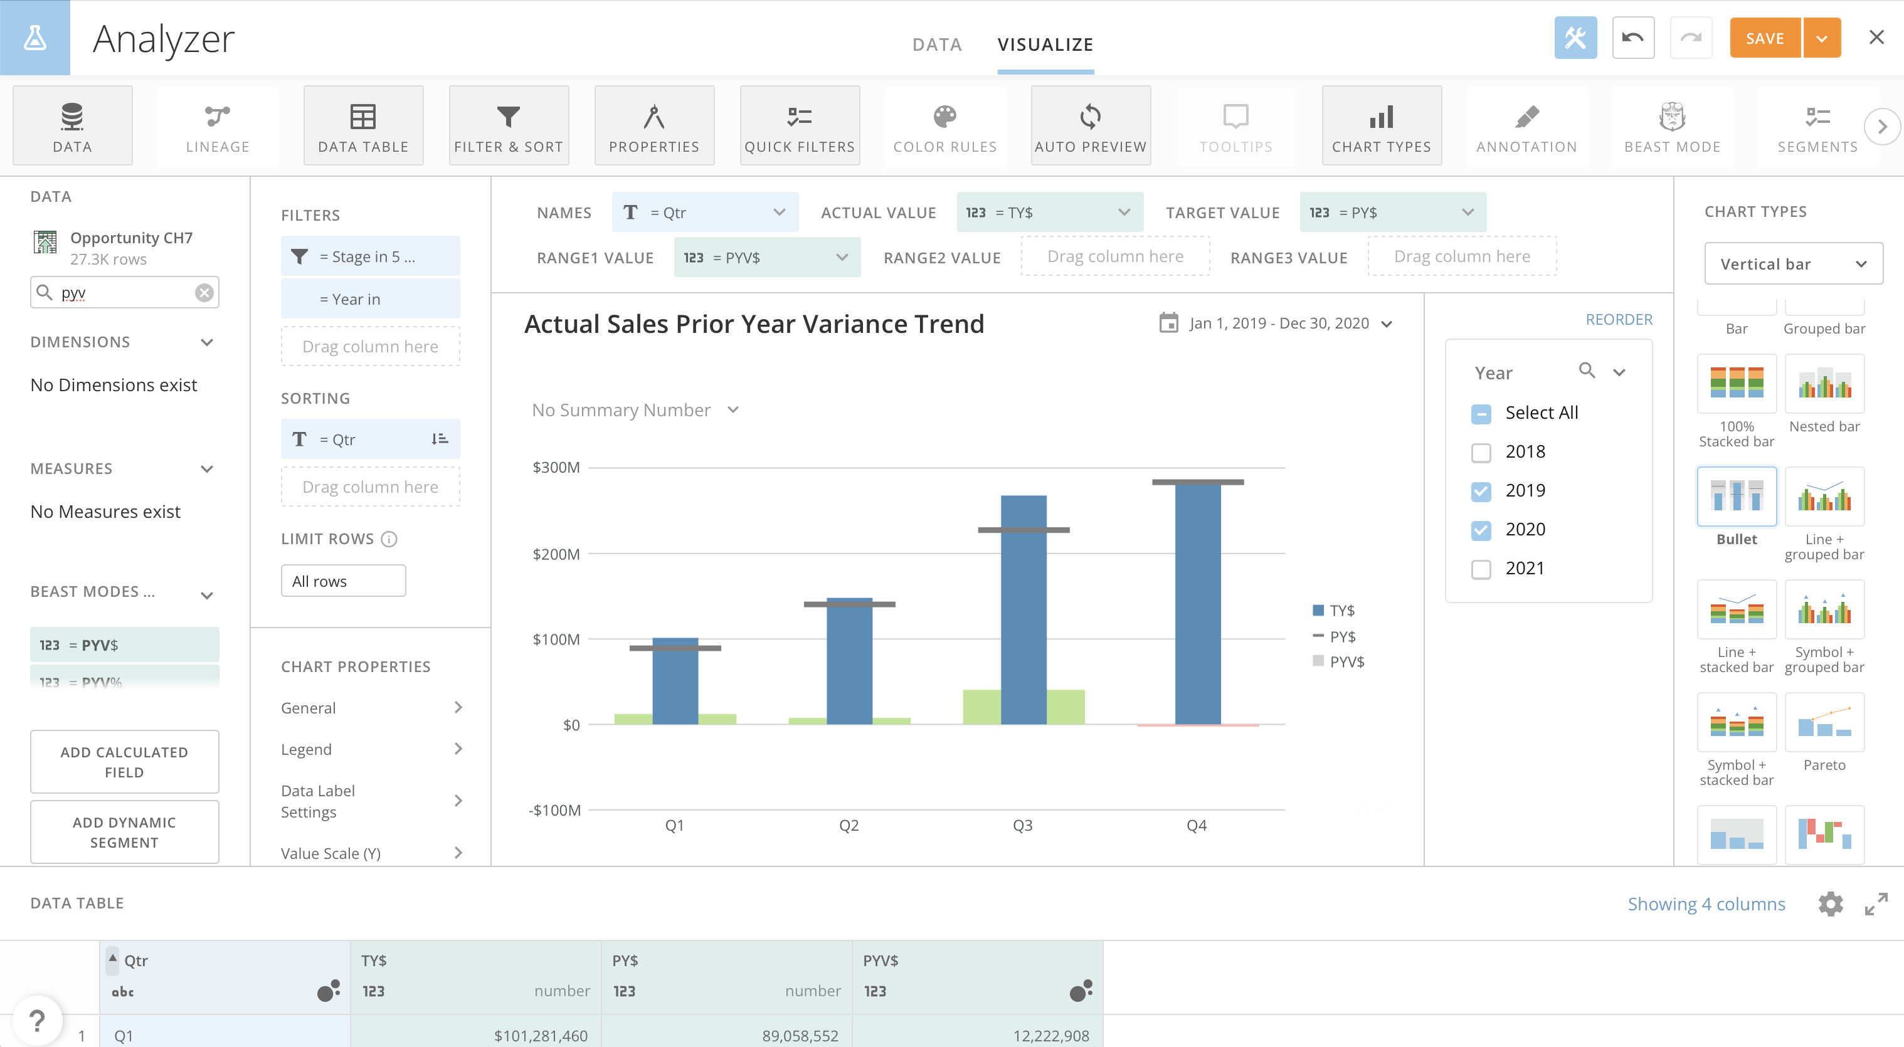

Slide 15
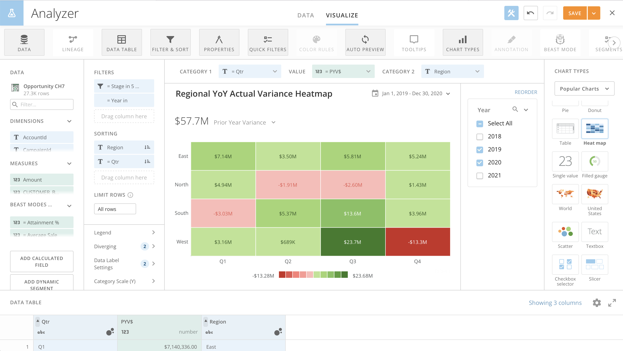

Slide 16
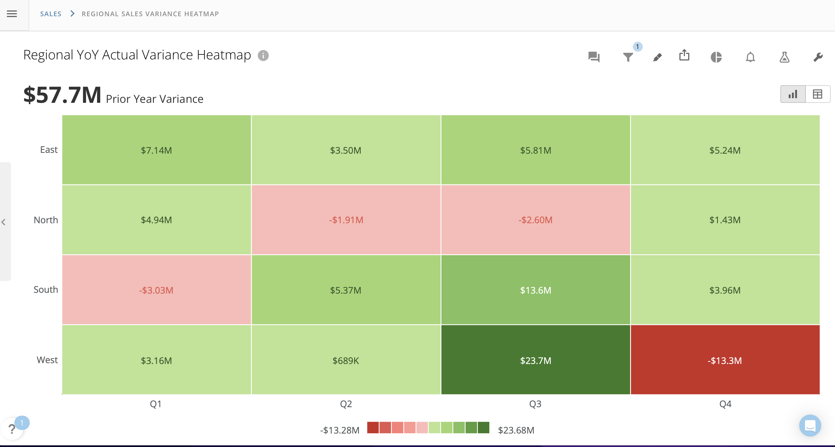

Slide 17
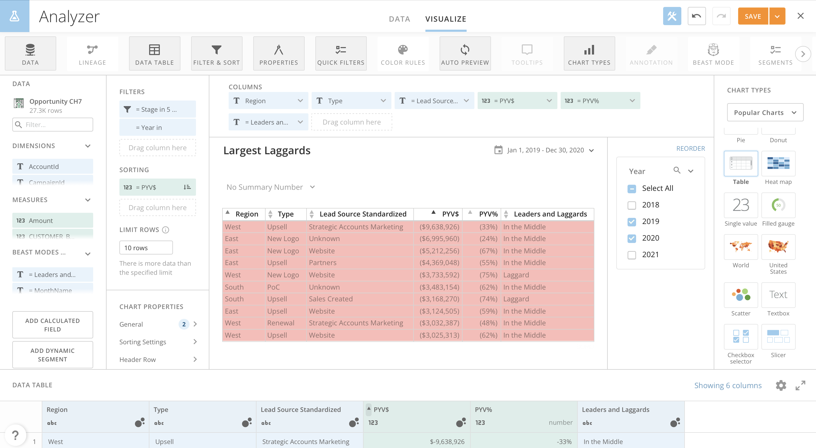

Slide 18
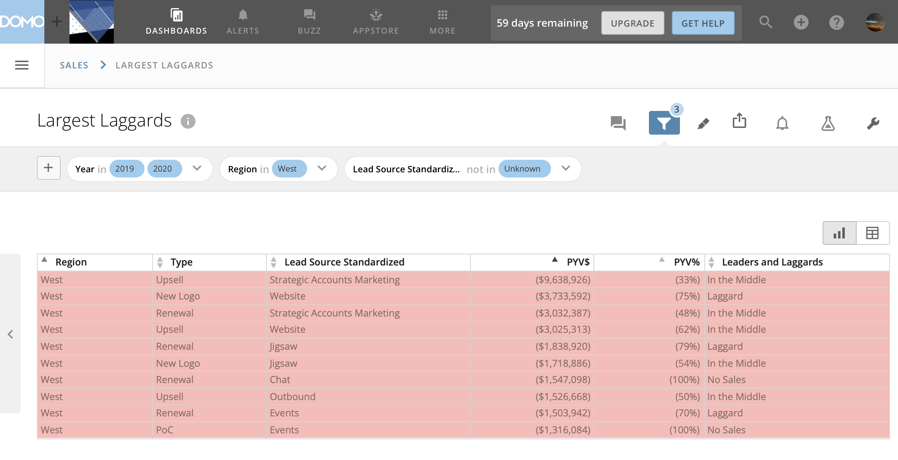

Slide 19
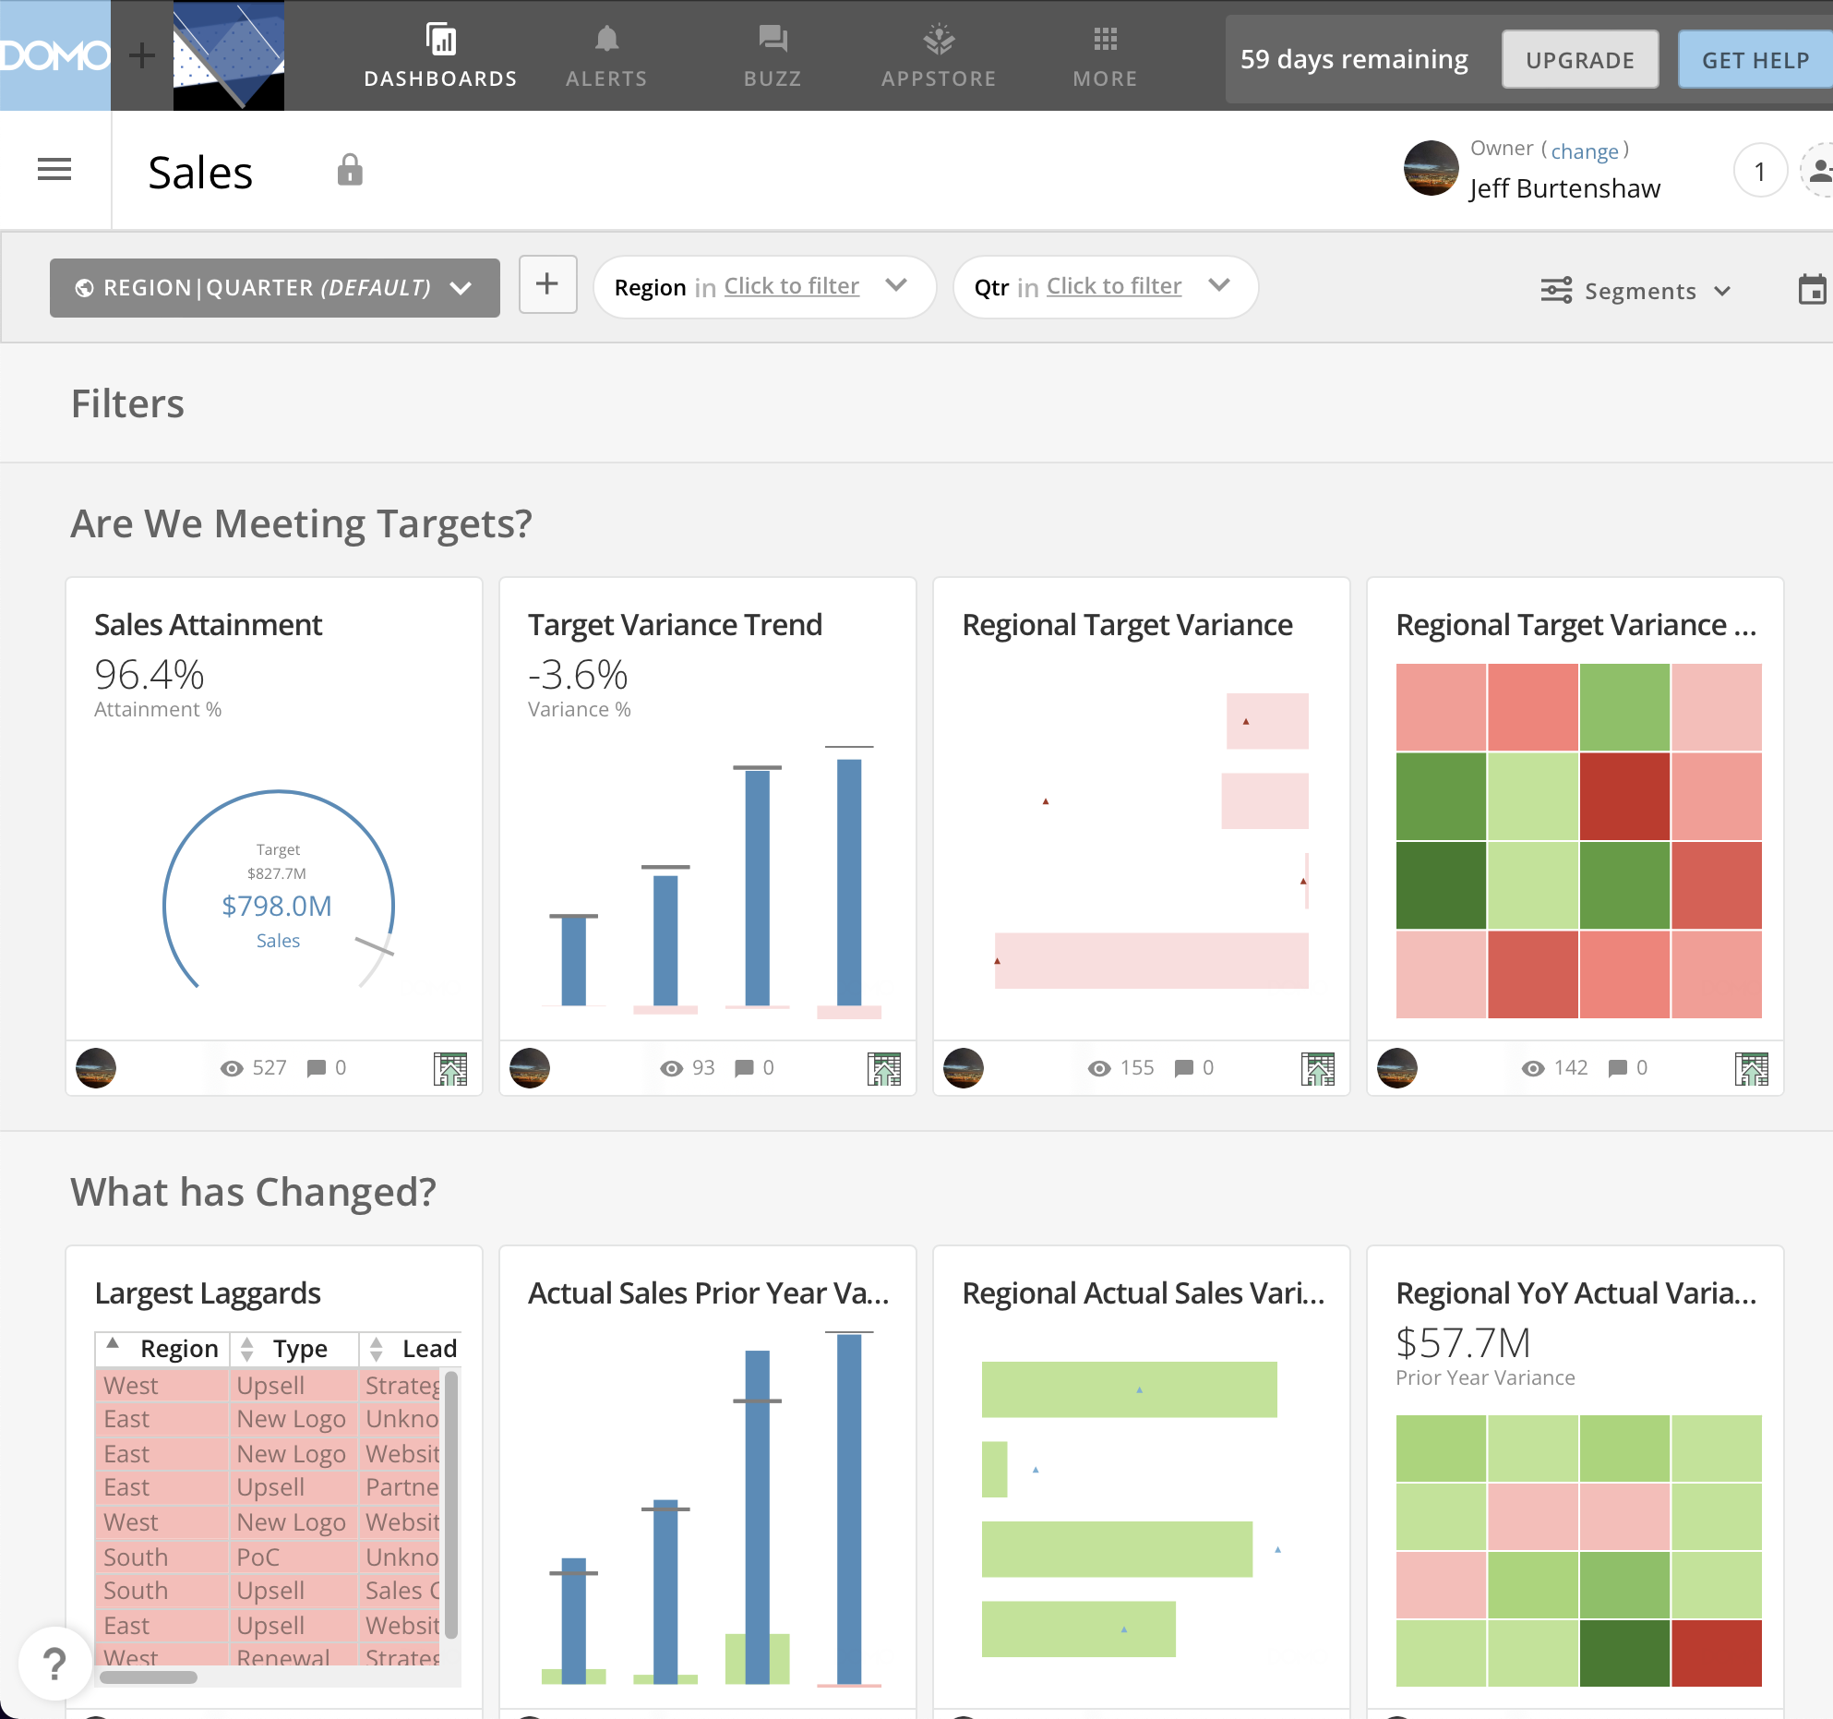

Slide 20
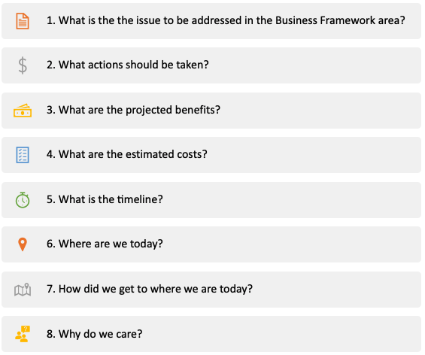

Slide 21
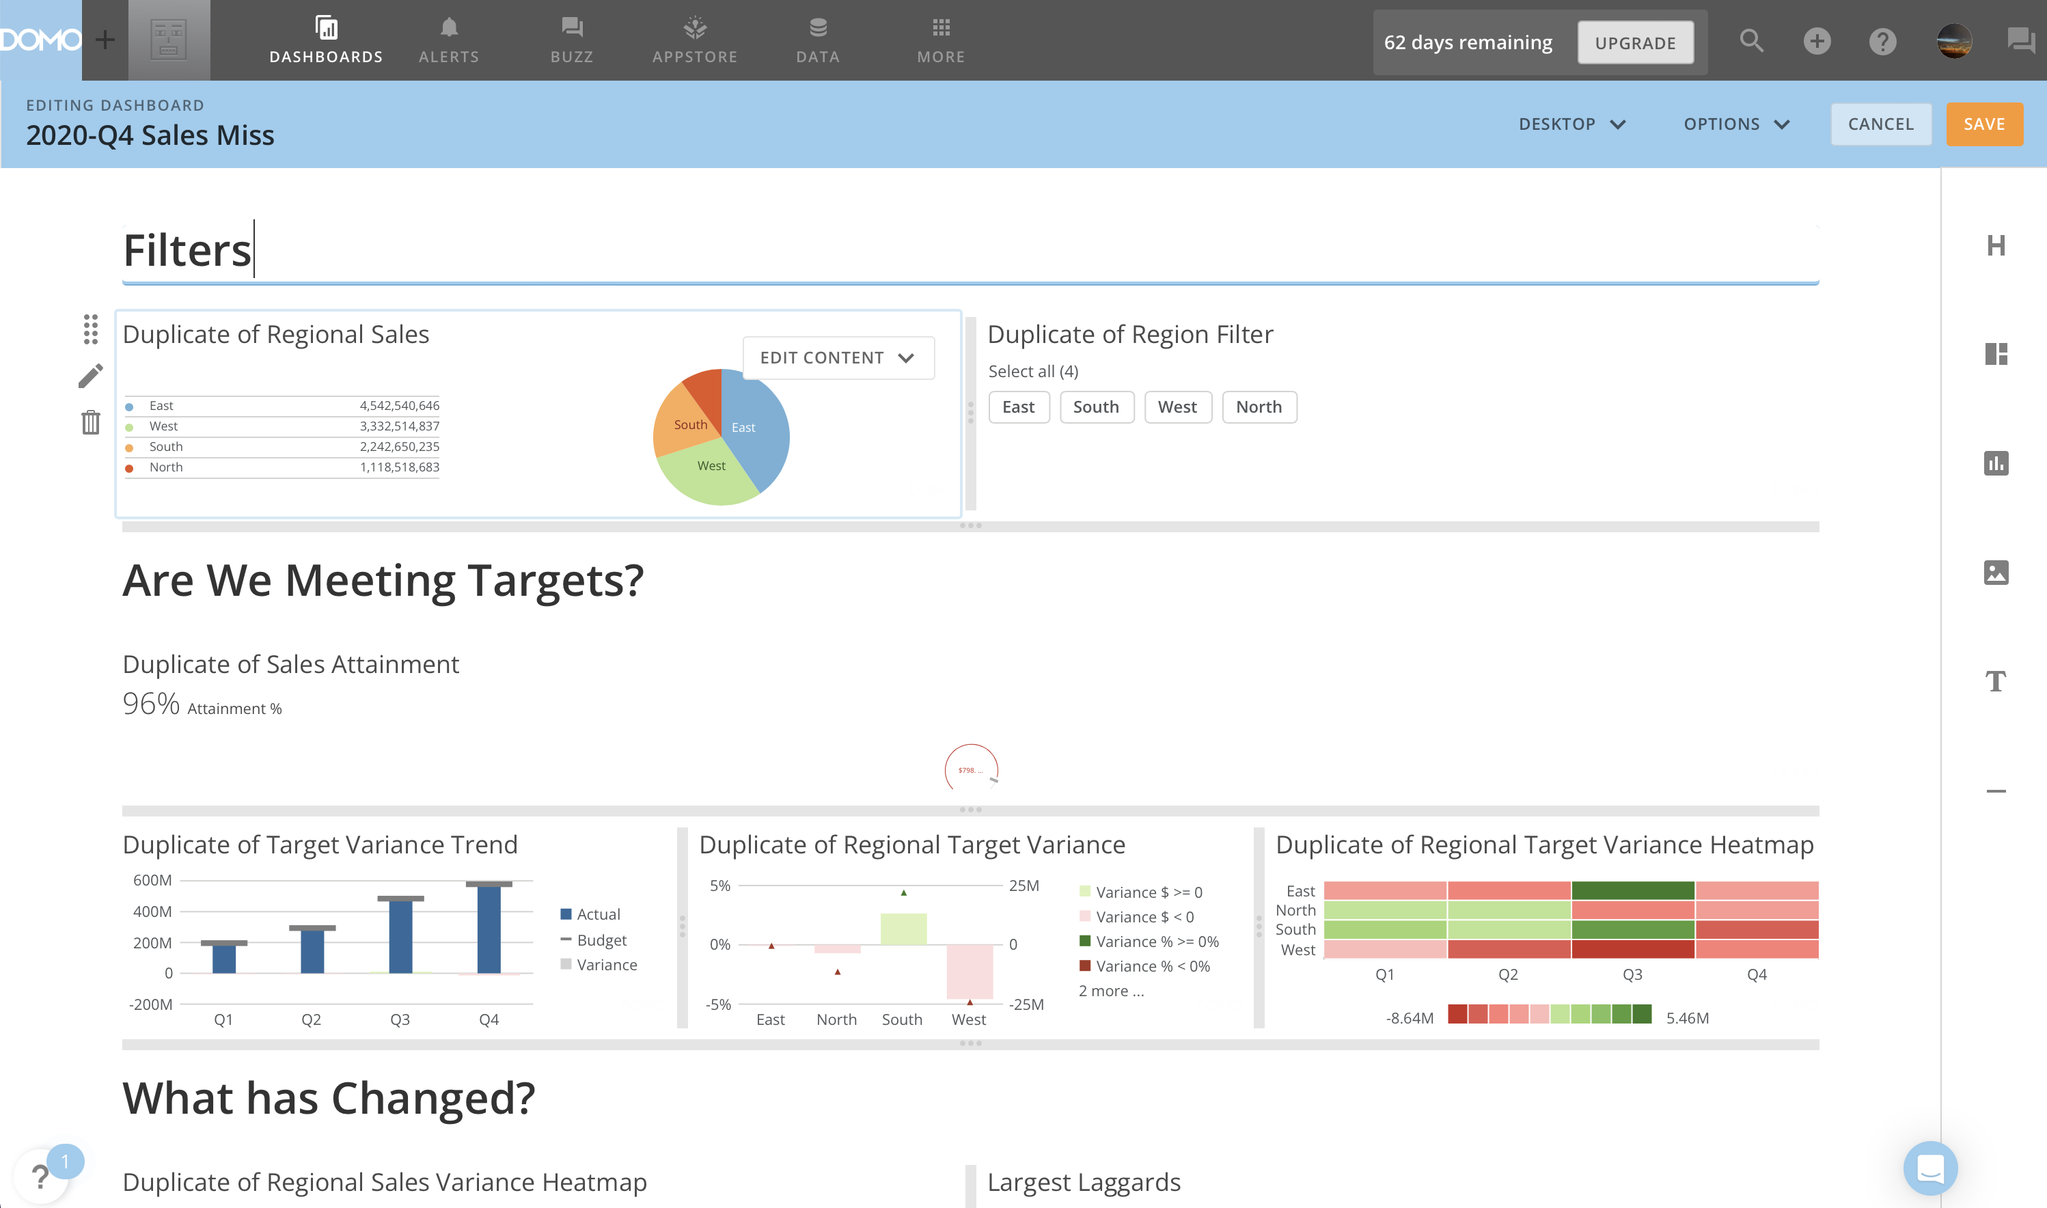
Artifact Toolbar
Arrange
layout
Edit Content
Preview
Options
Header
Layout
Change
layout
Card
Image
Remove
layout
Frames
Text
Border

Slide 22
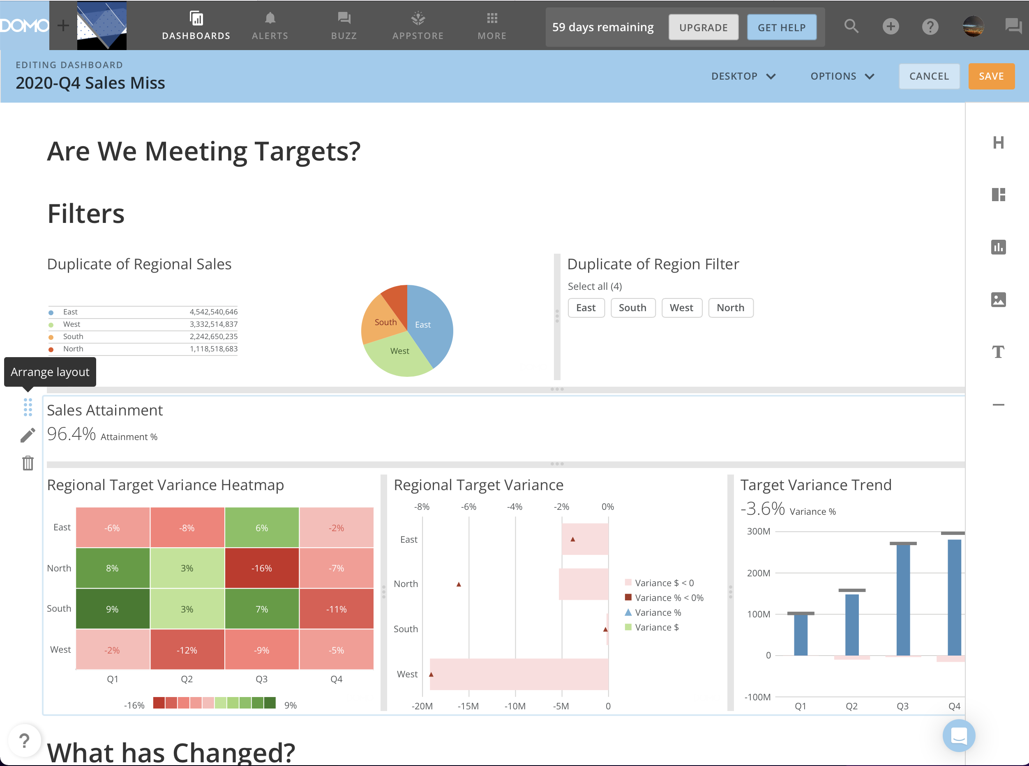

Slide 23
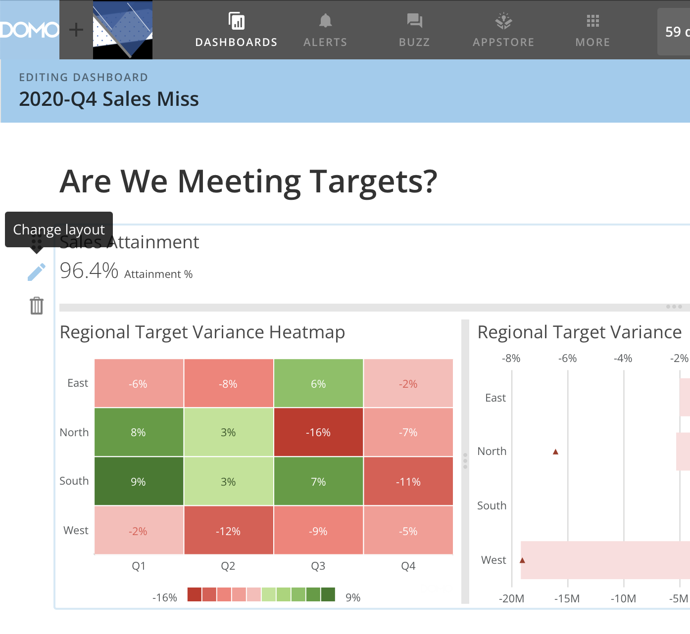

Slide 24
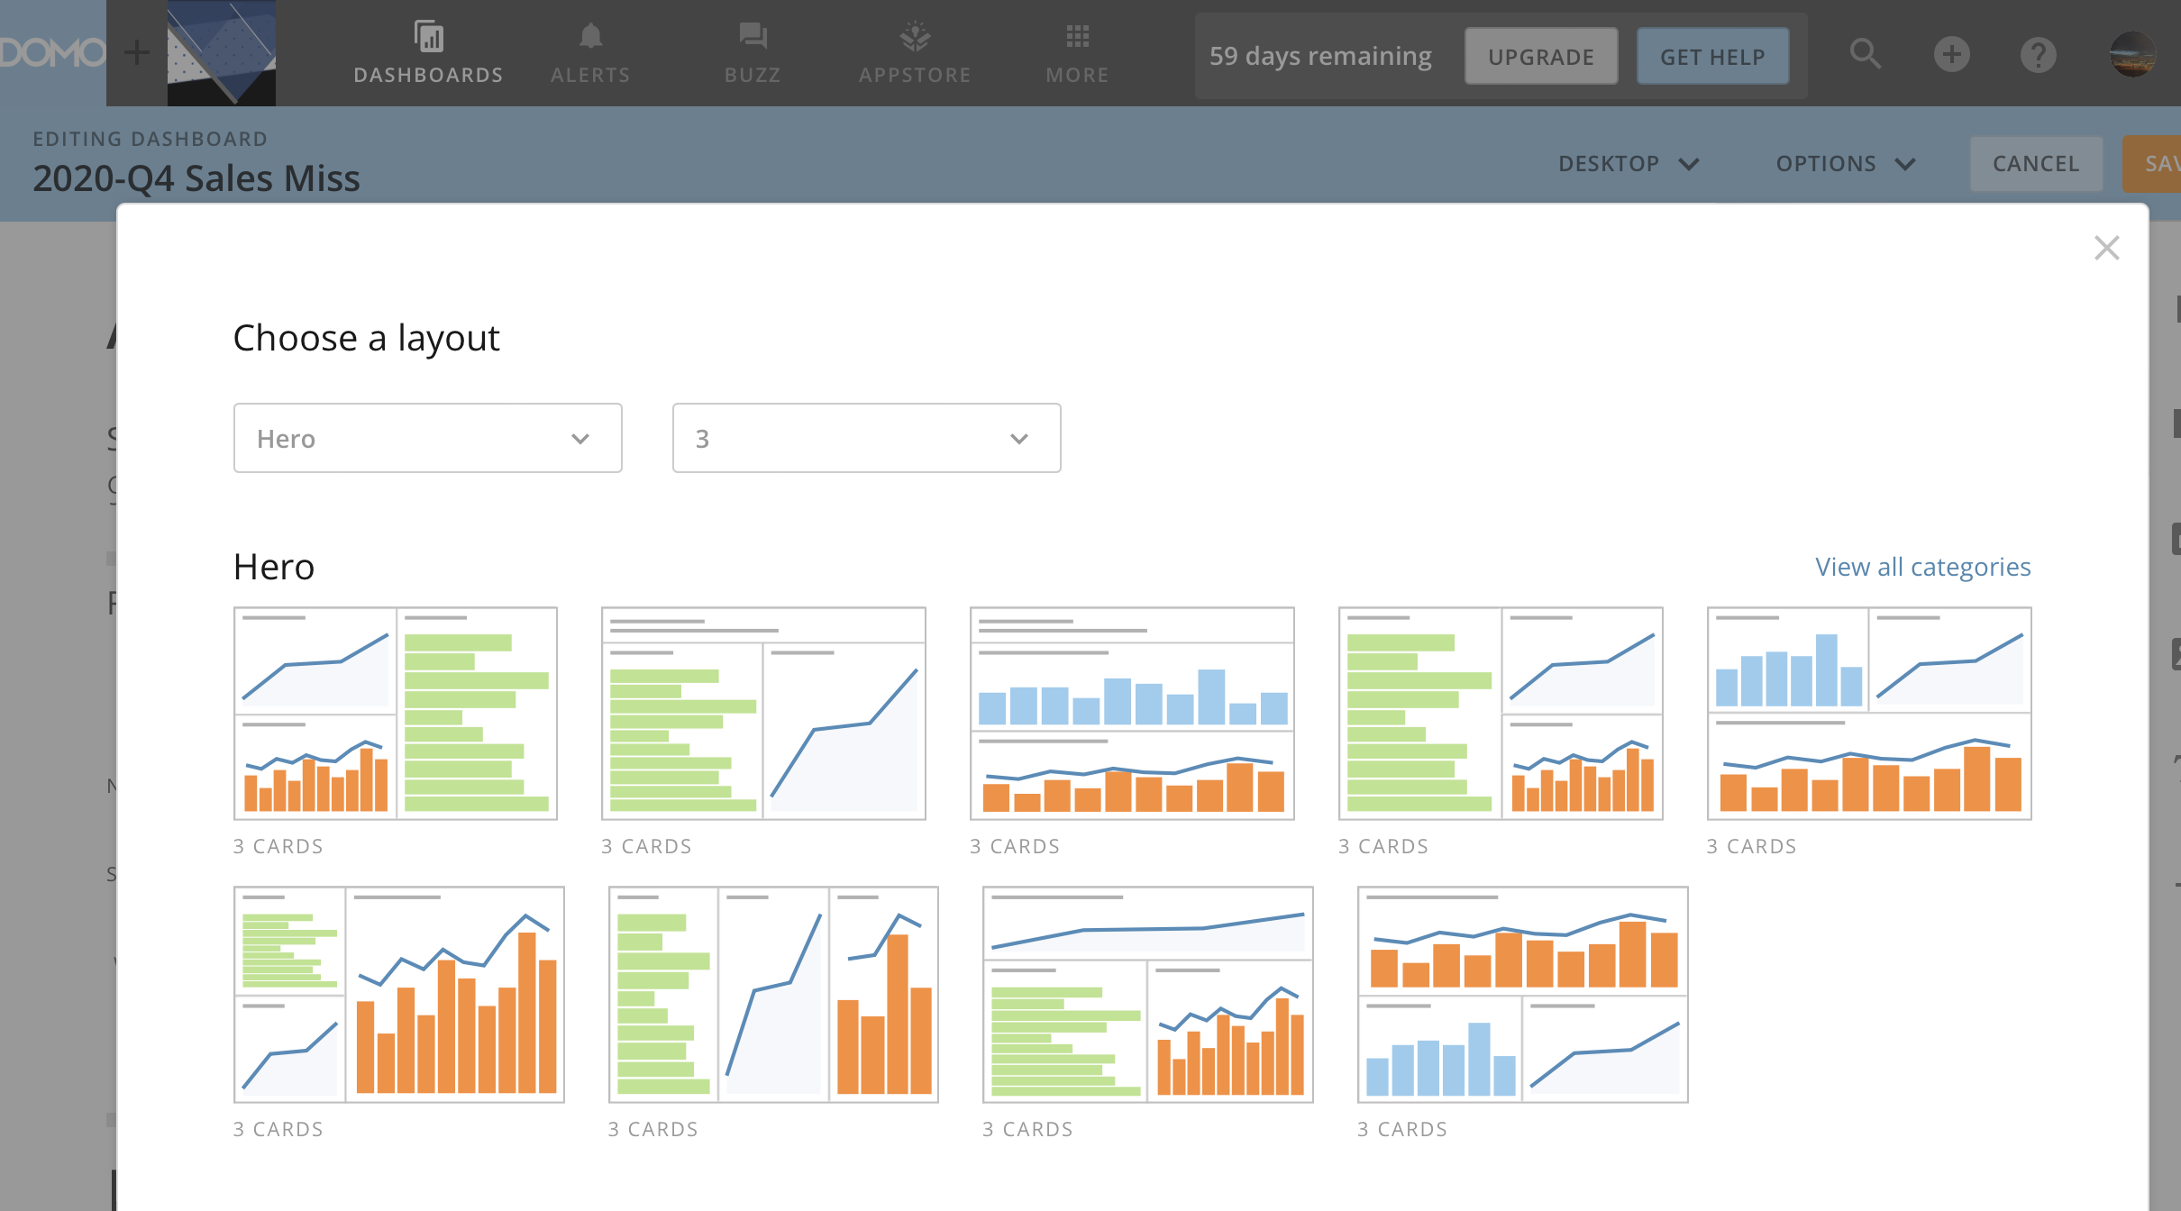

Slide 25
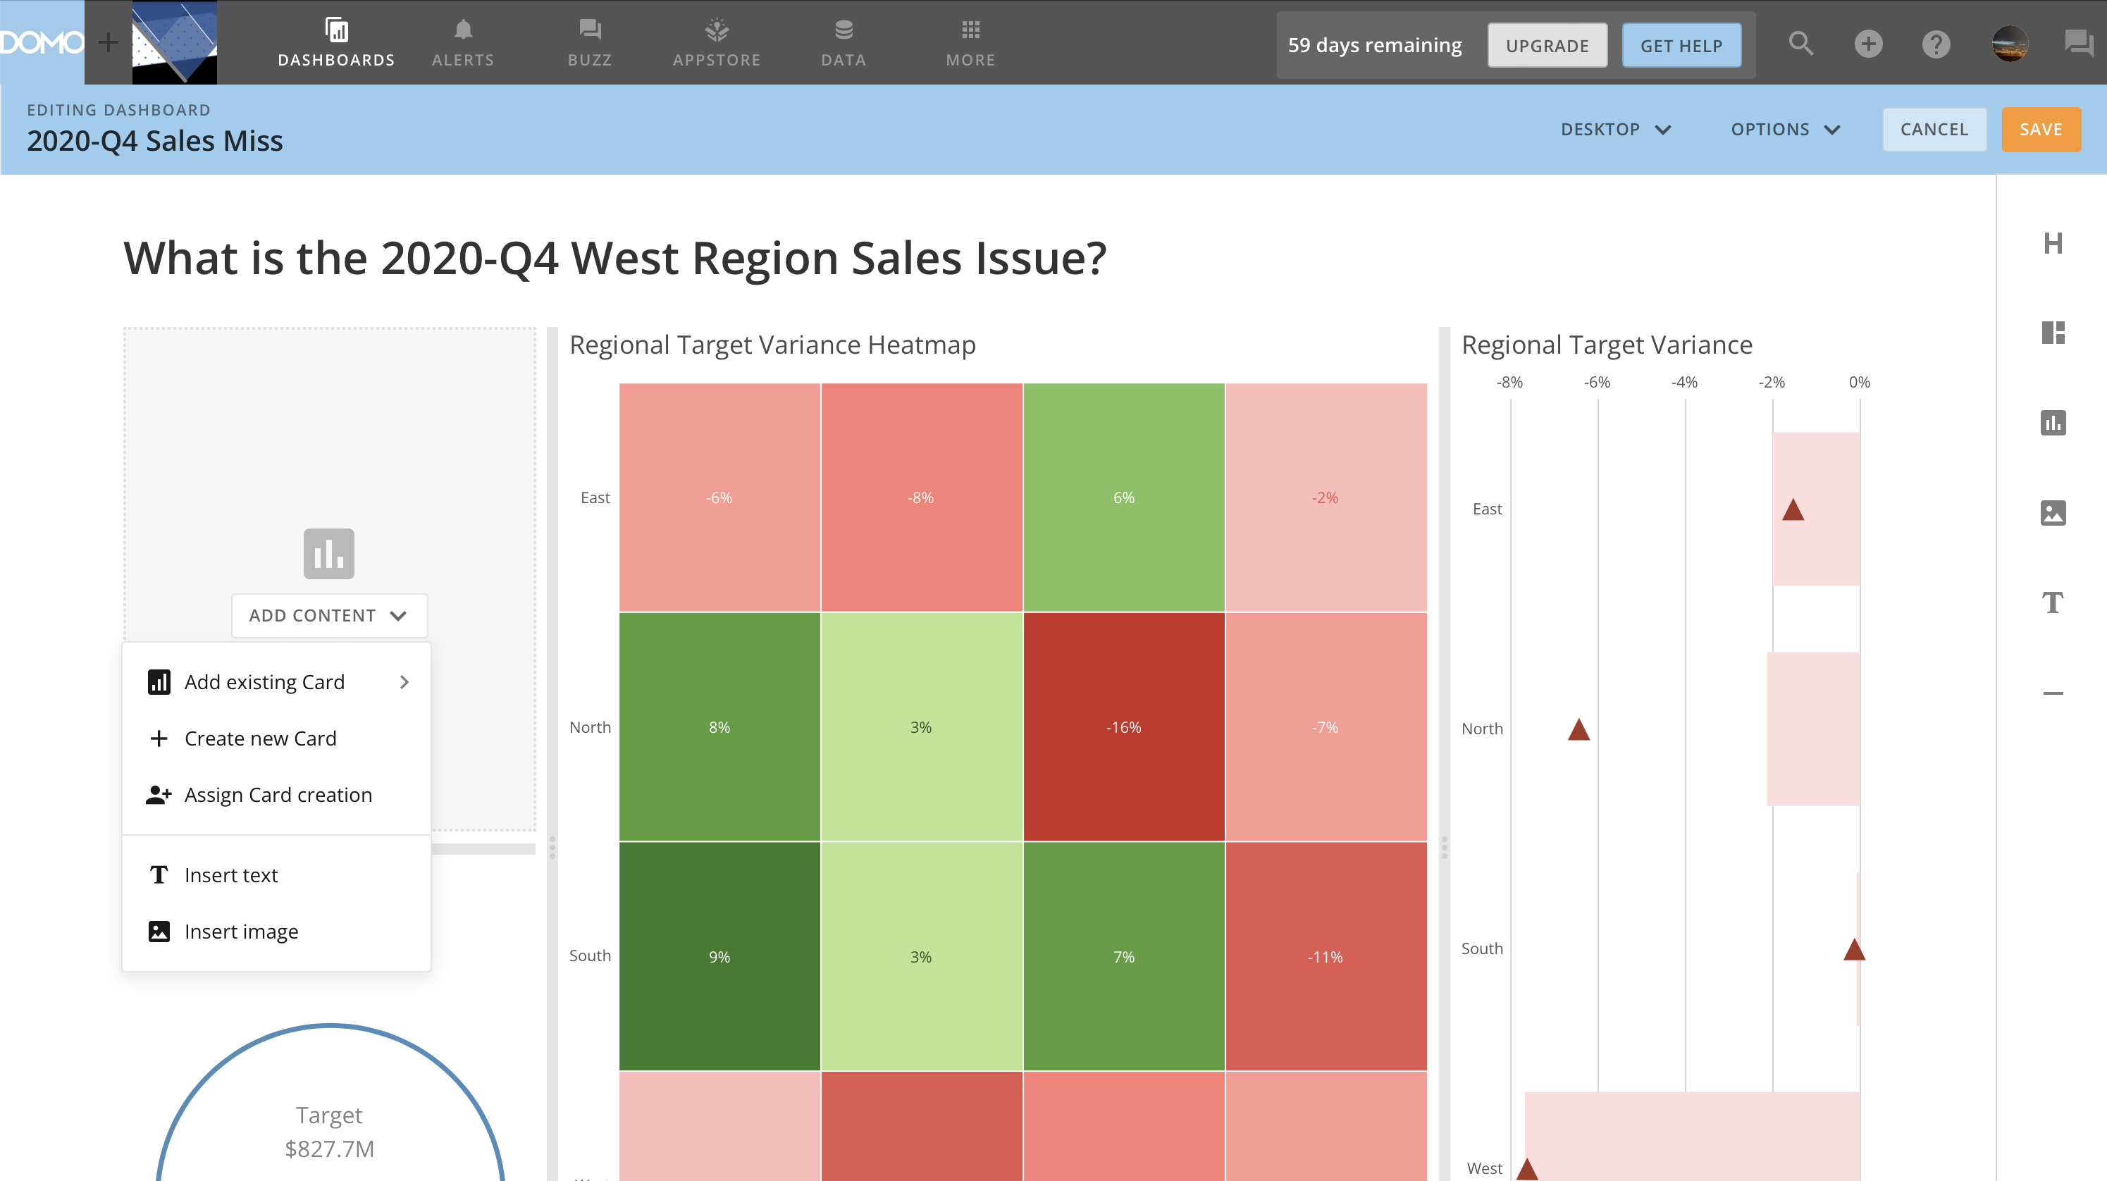

Slide 26
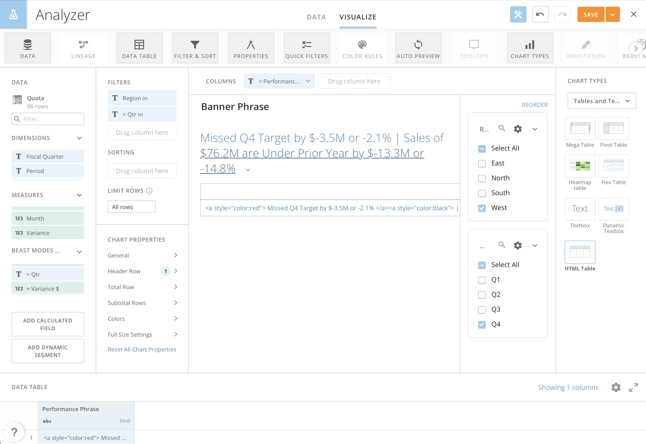

Slide 27
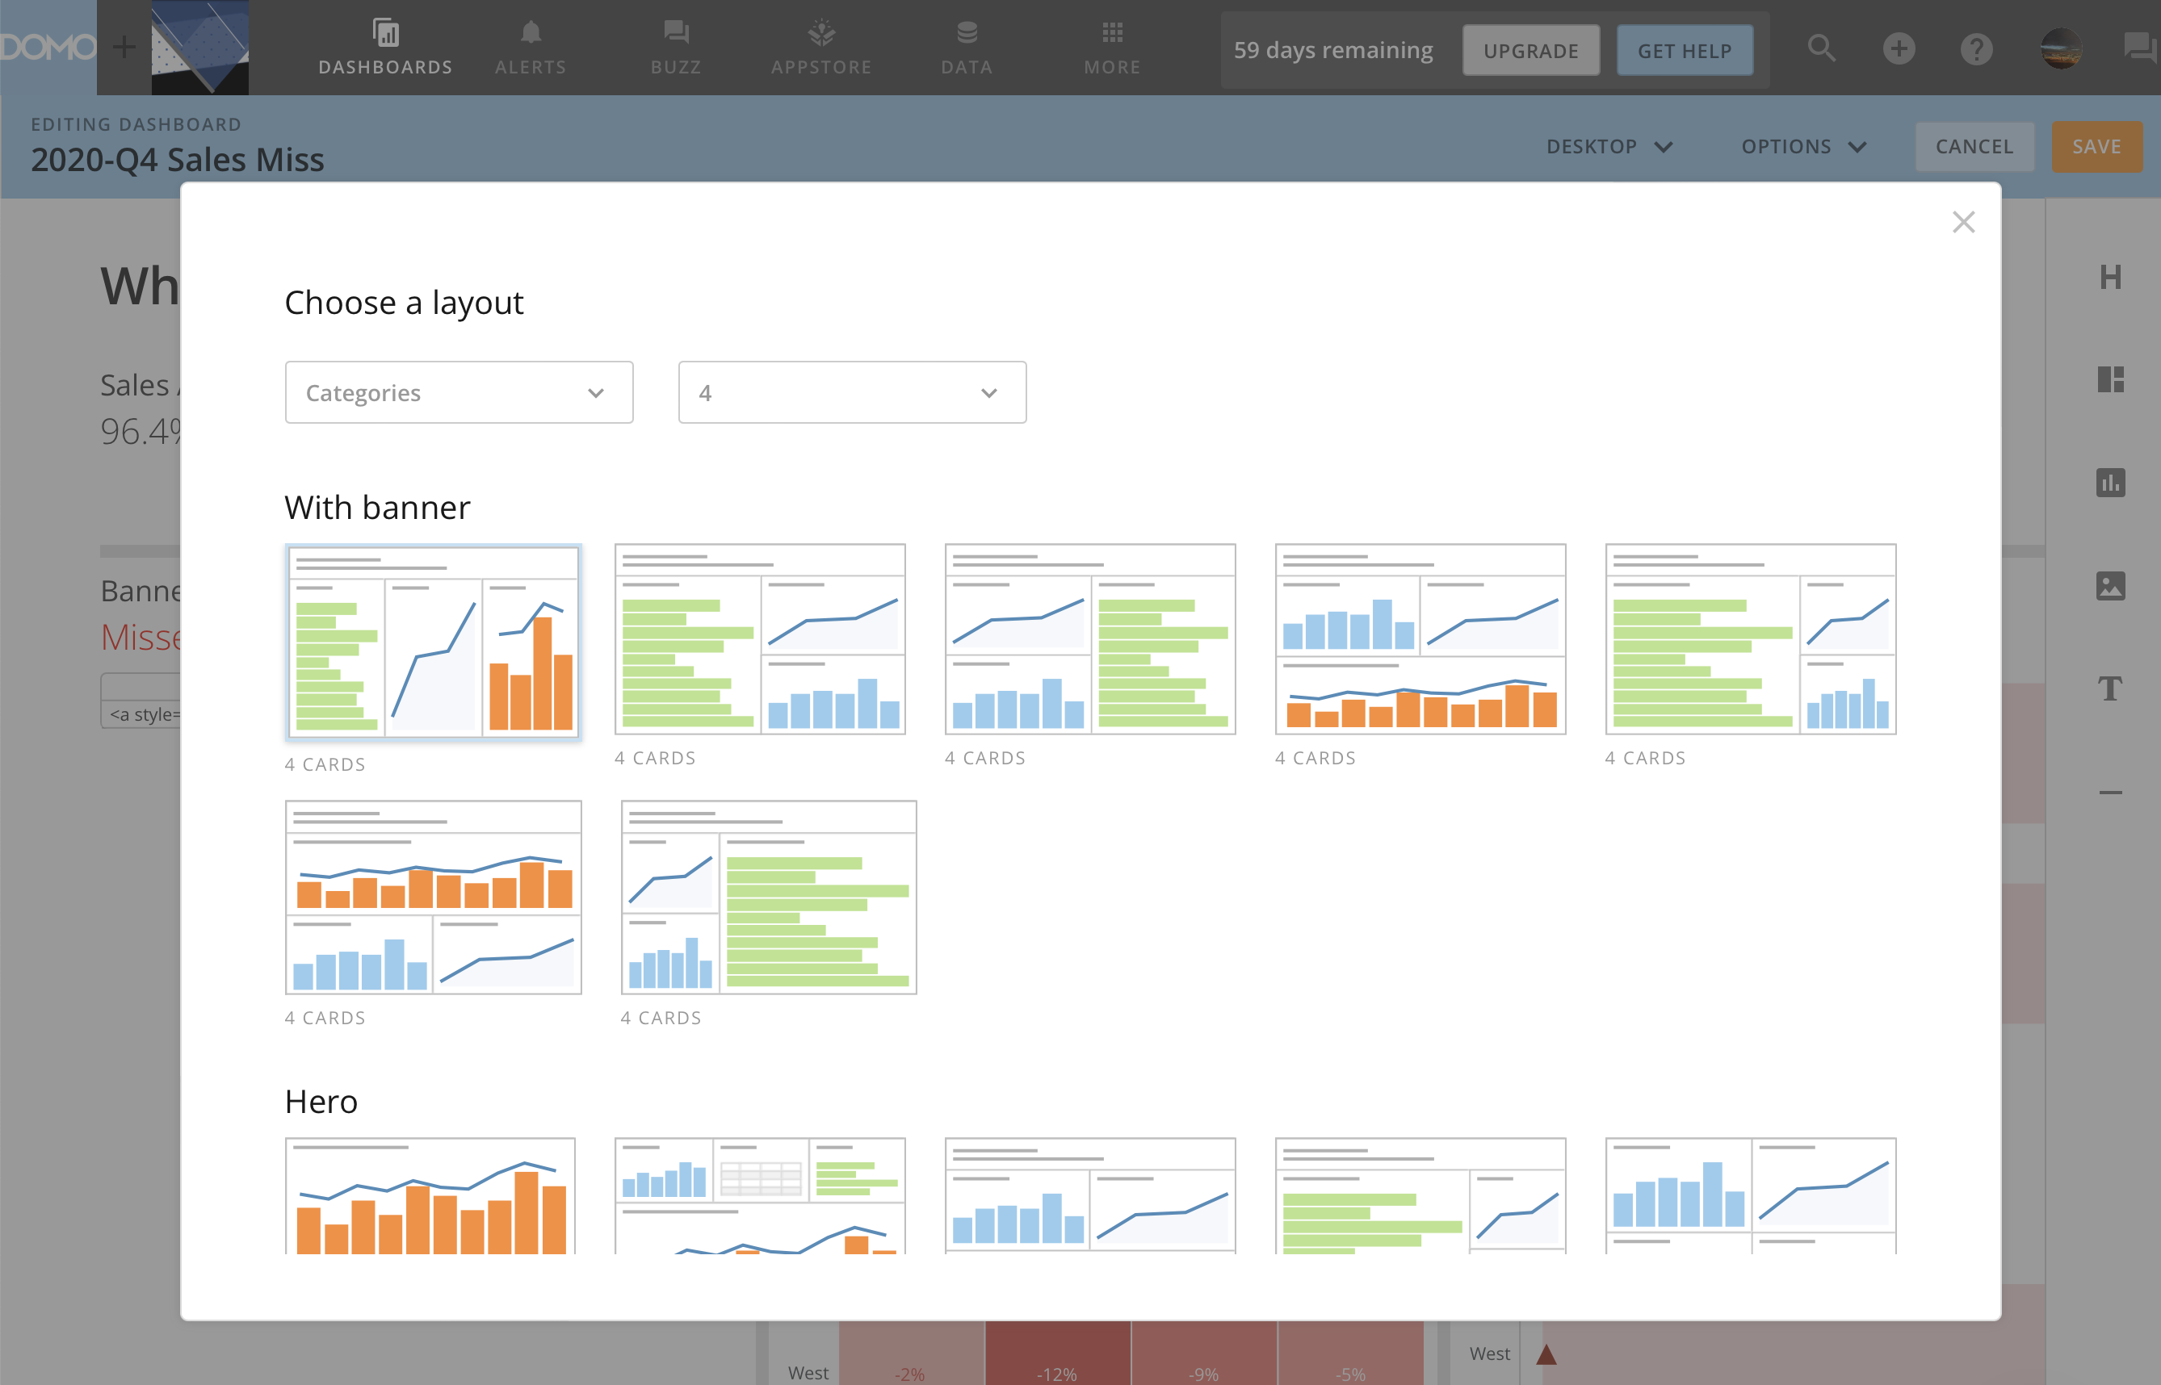

Slide 28
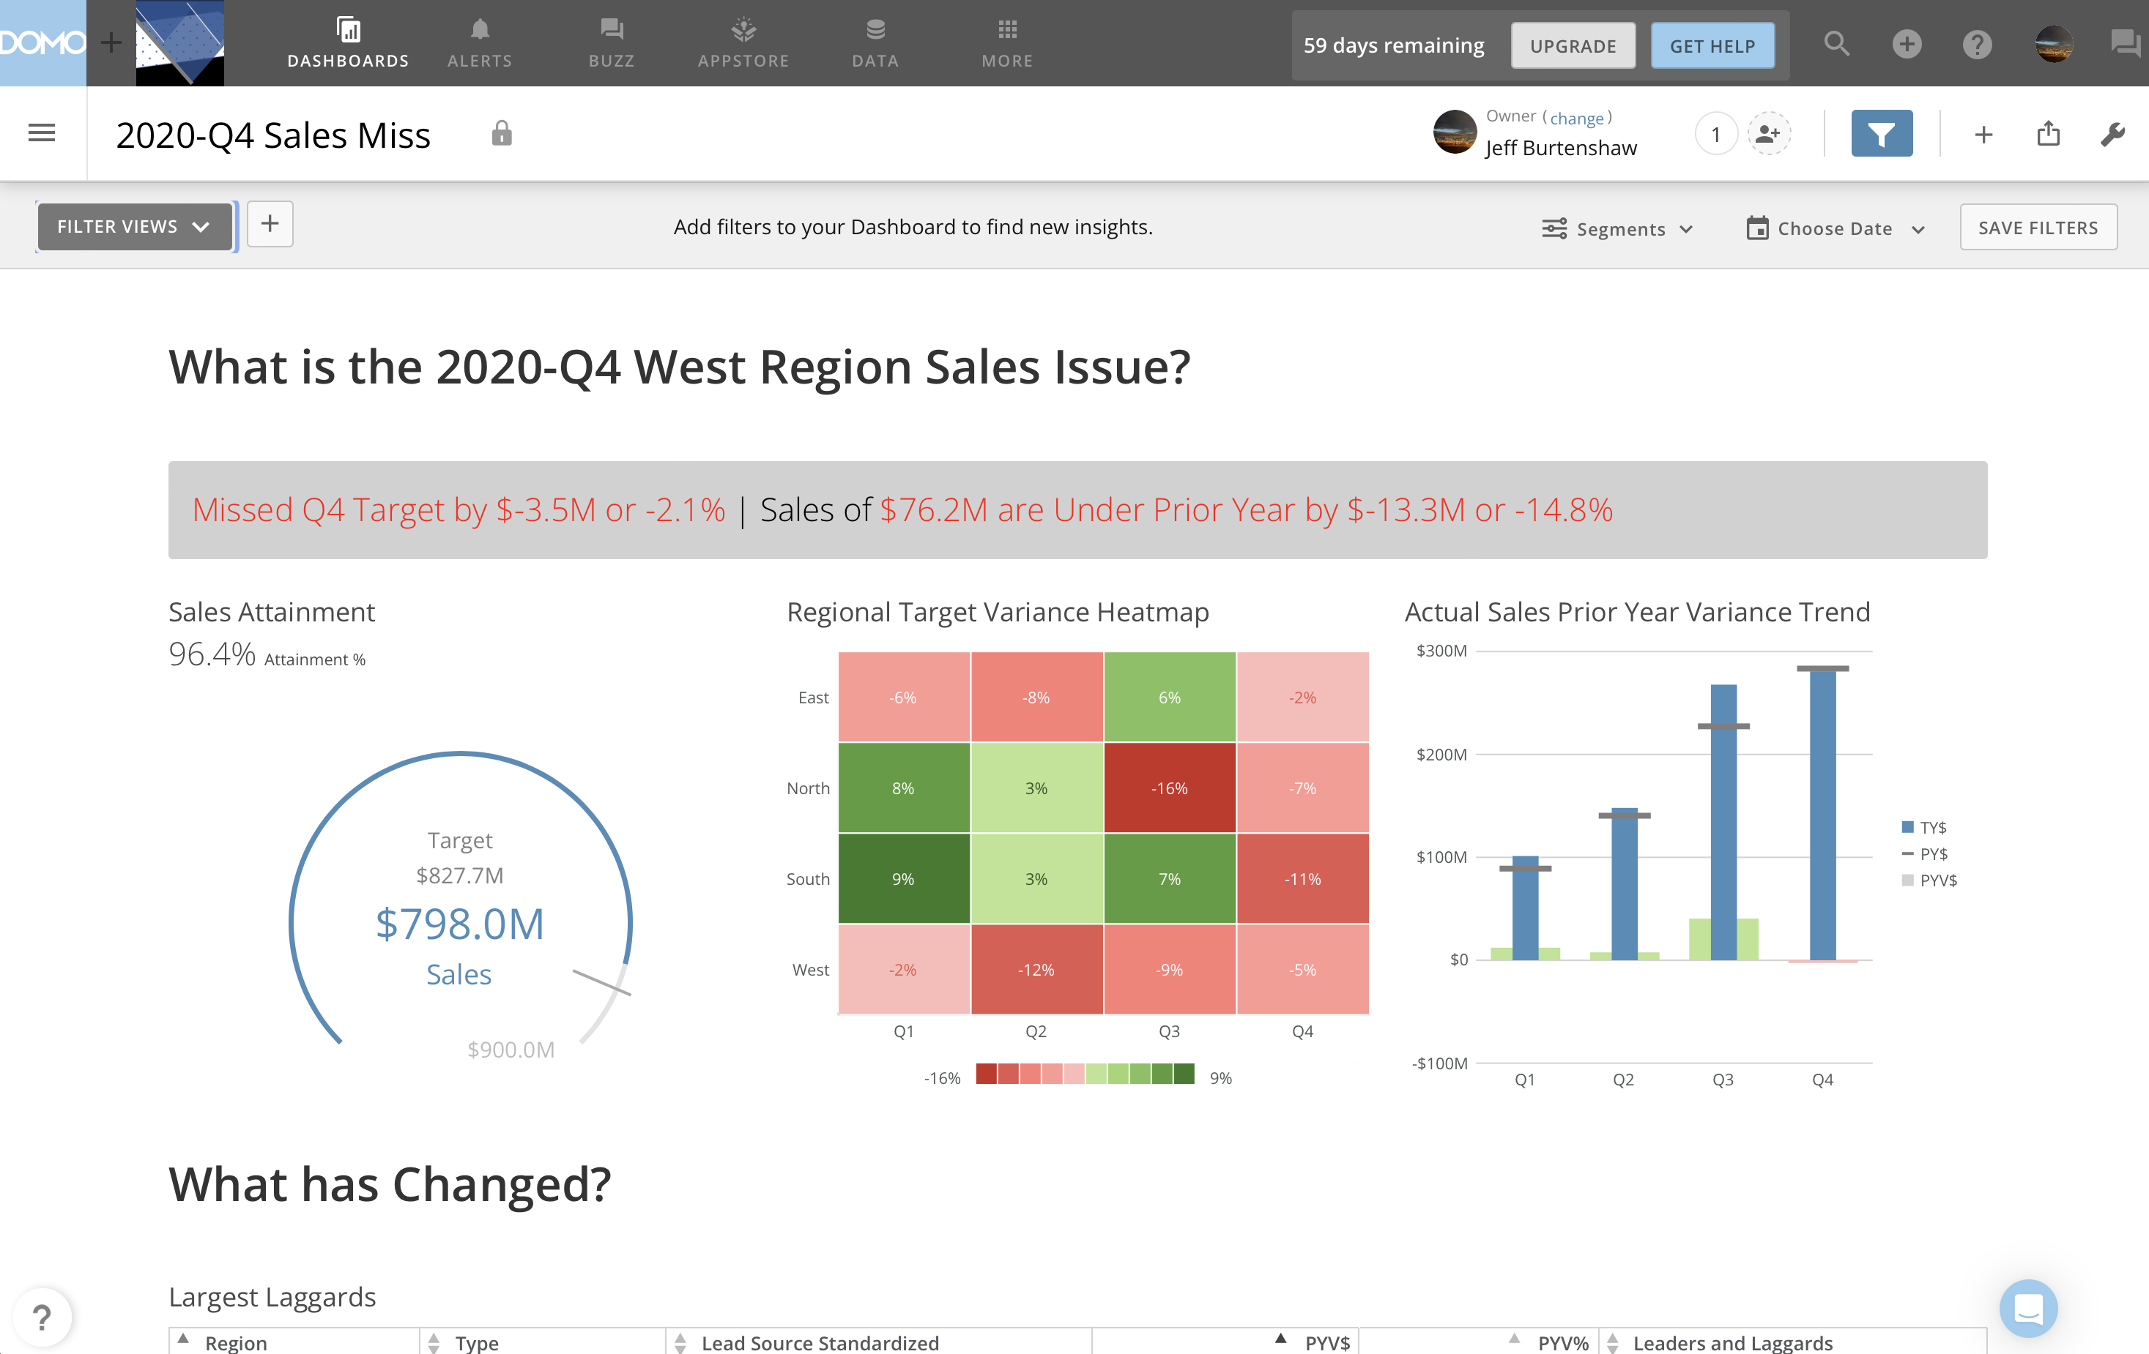

Slide 29
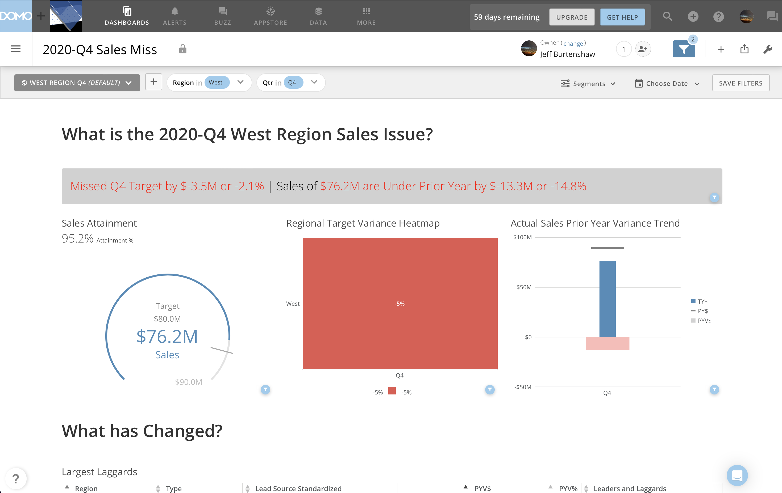

Slide 30
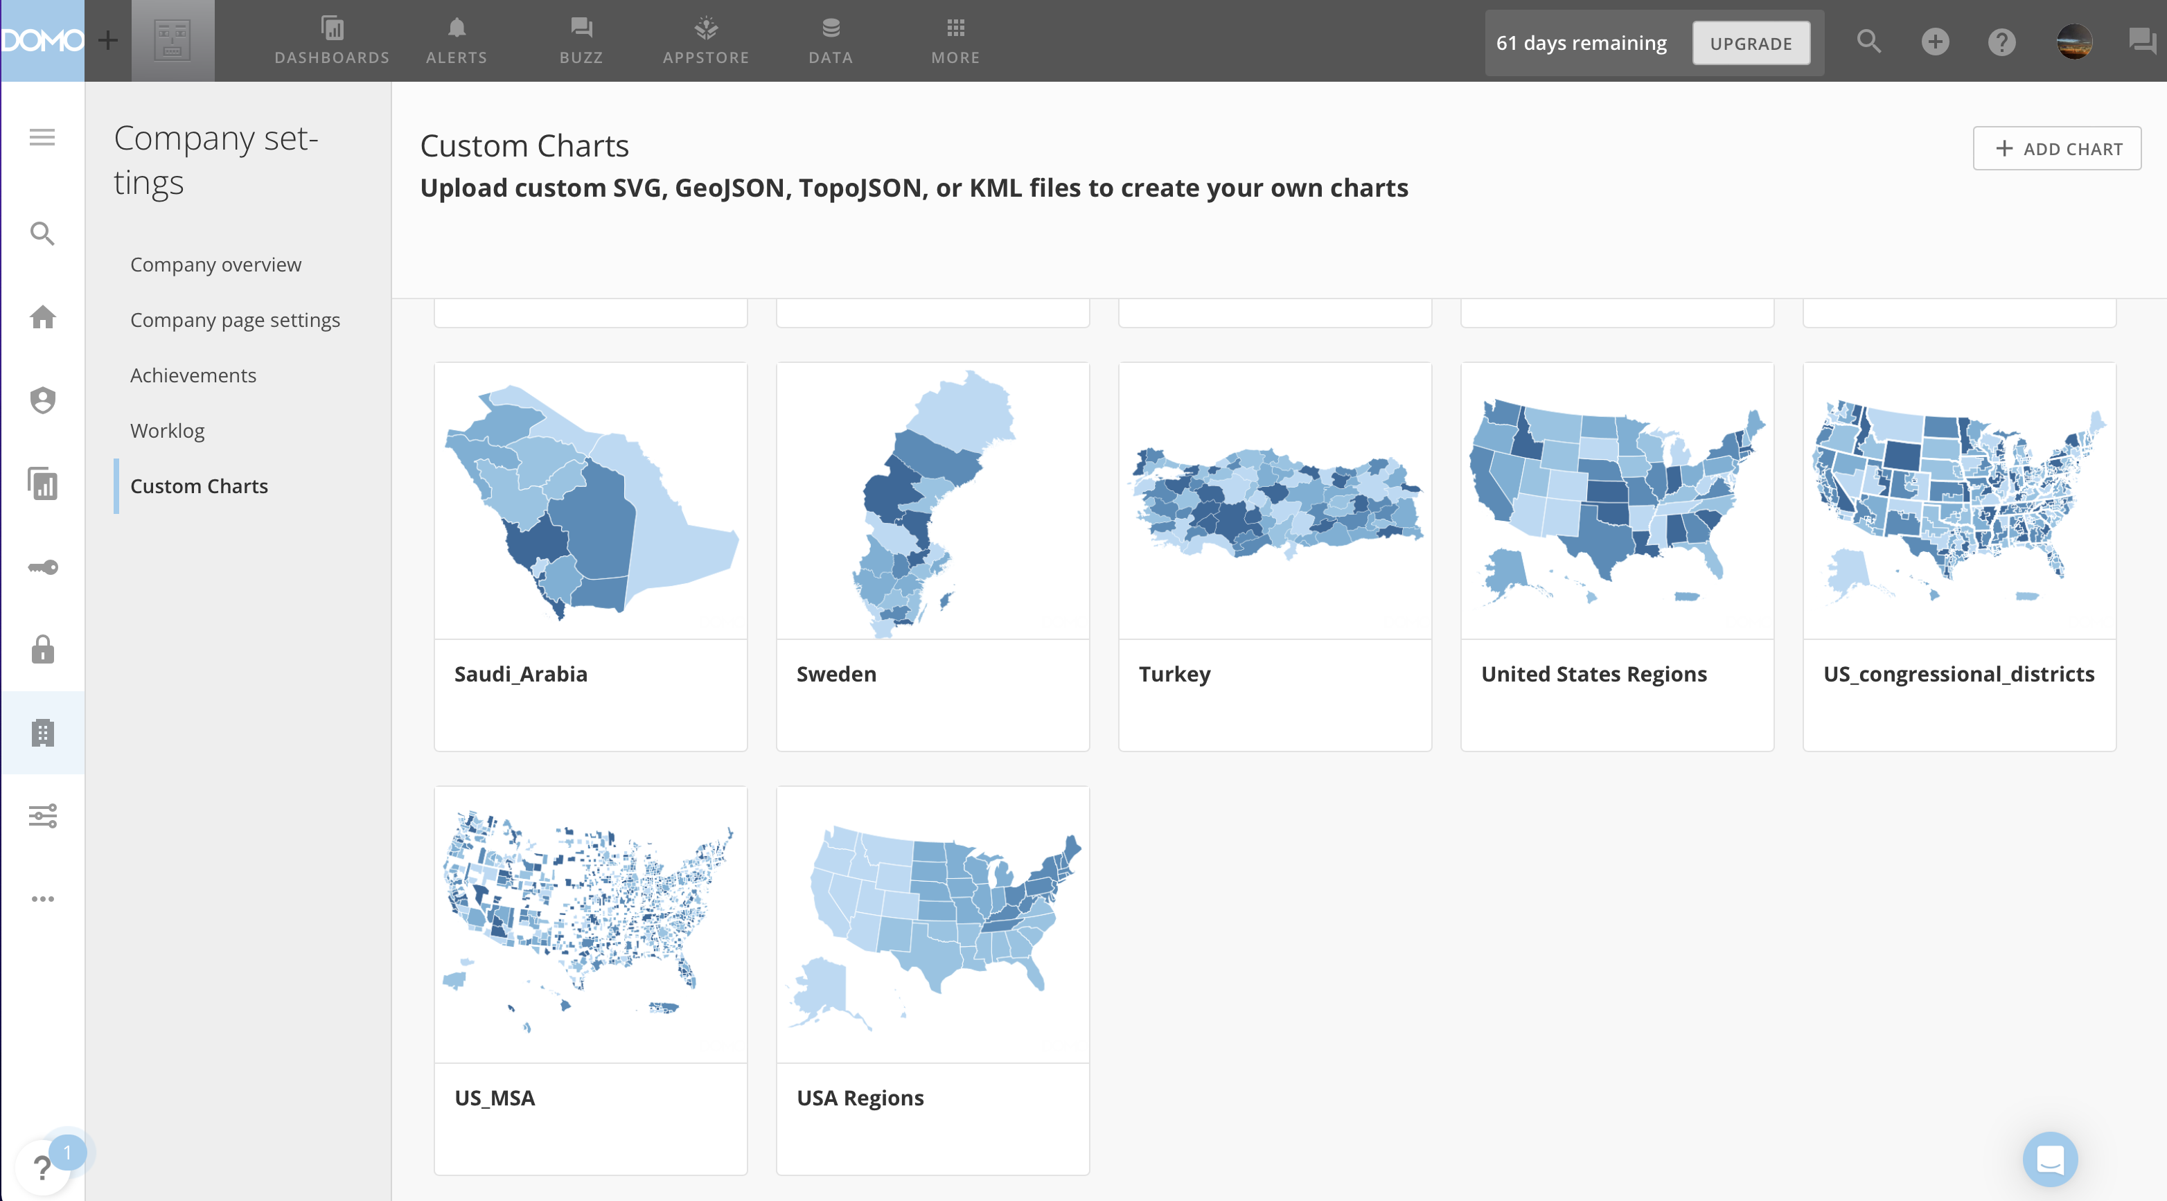

Slide 31
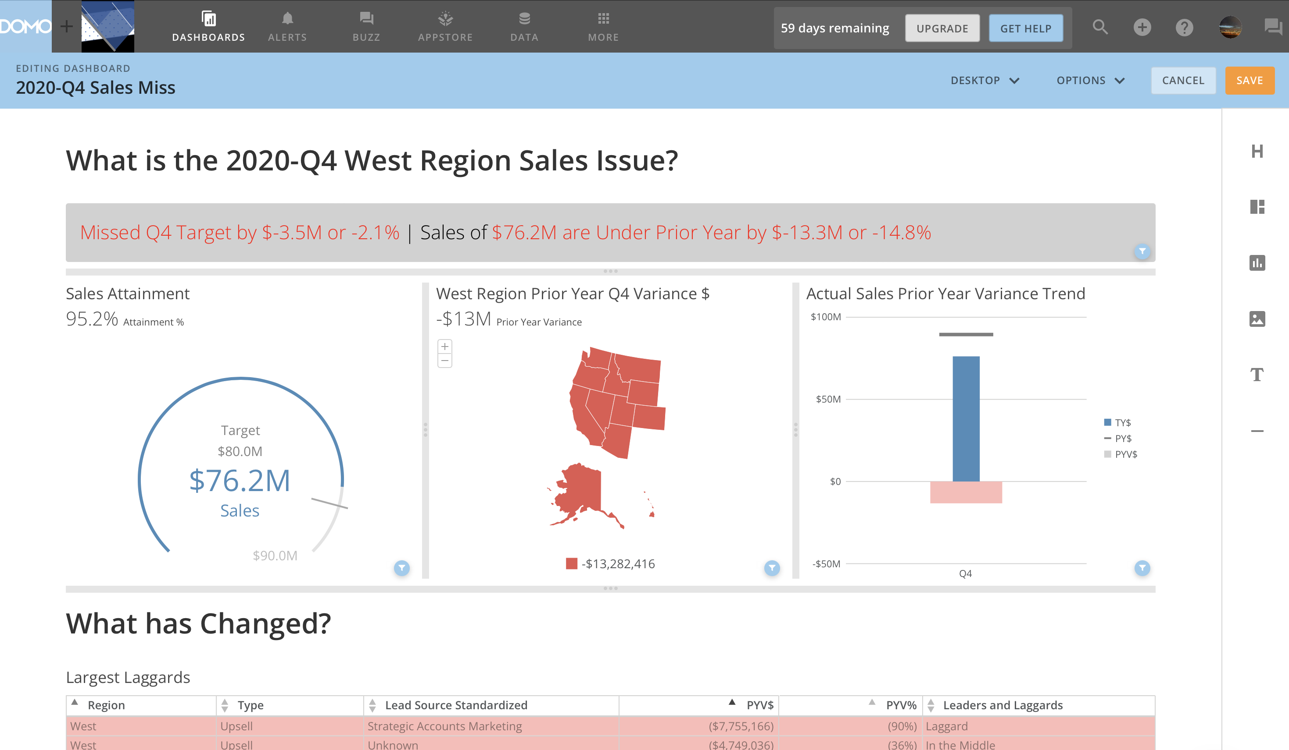

Slide 32
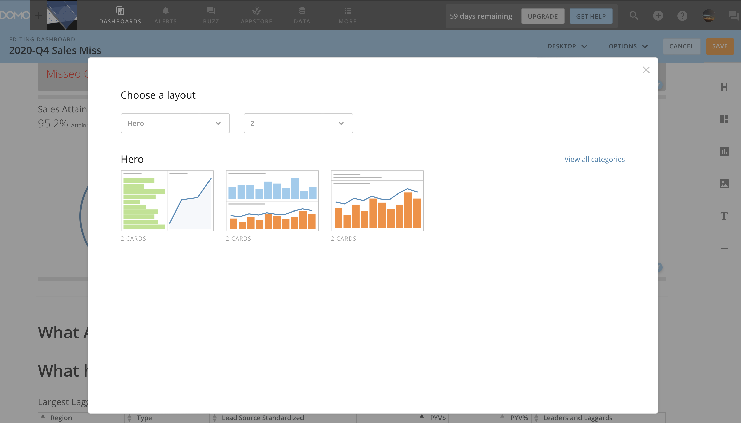

Slide 33
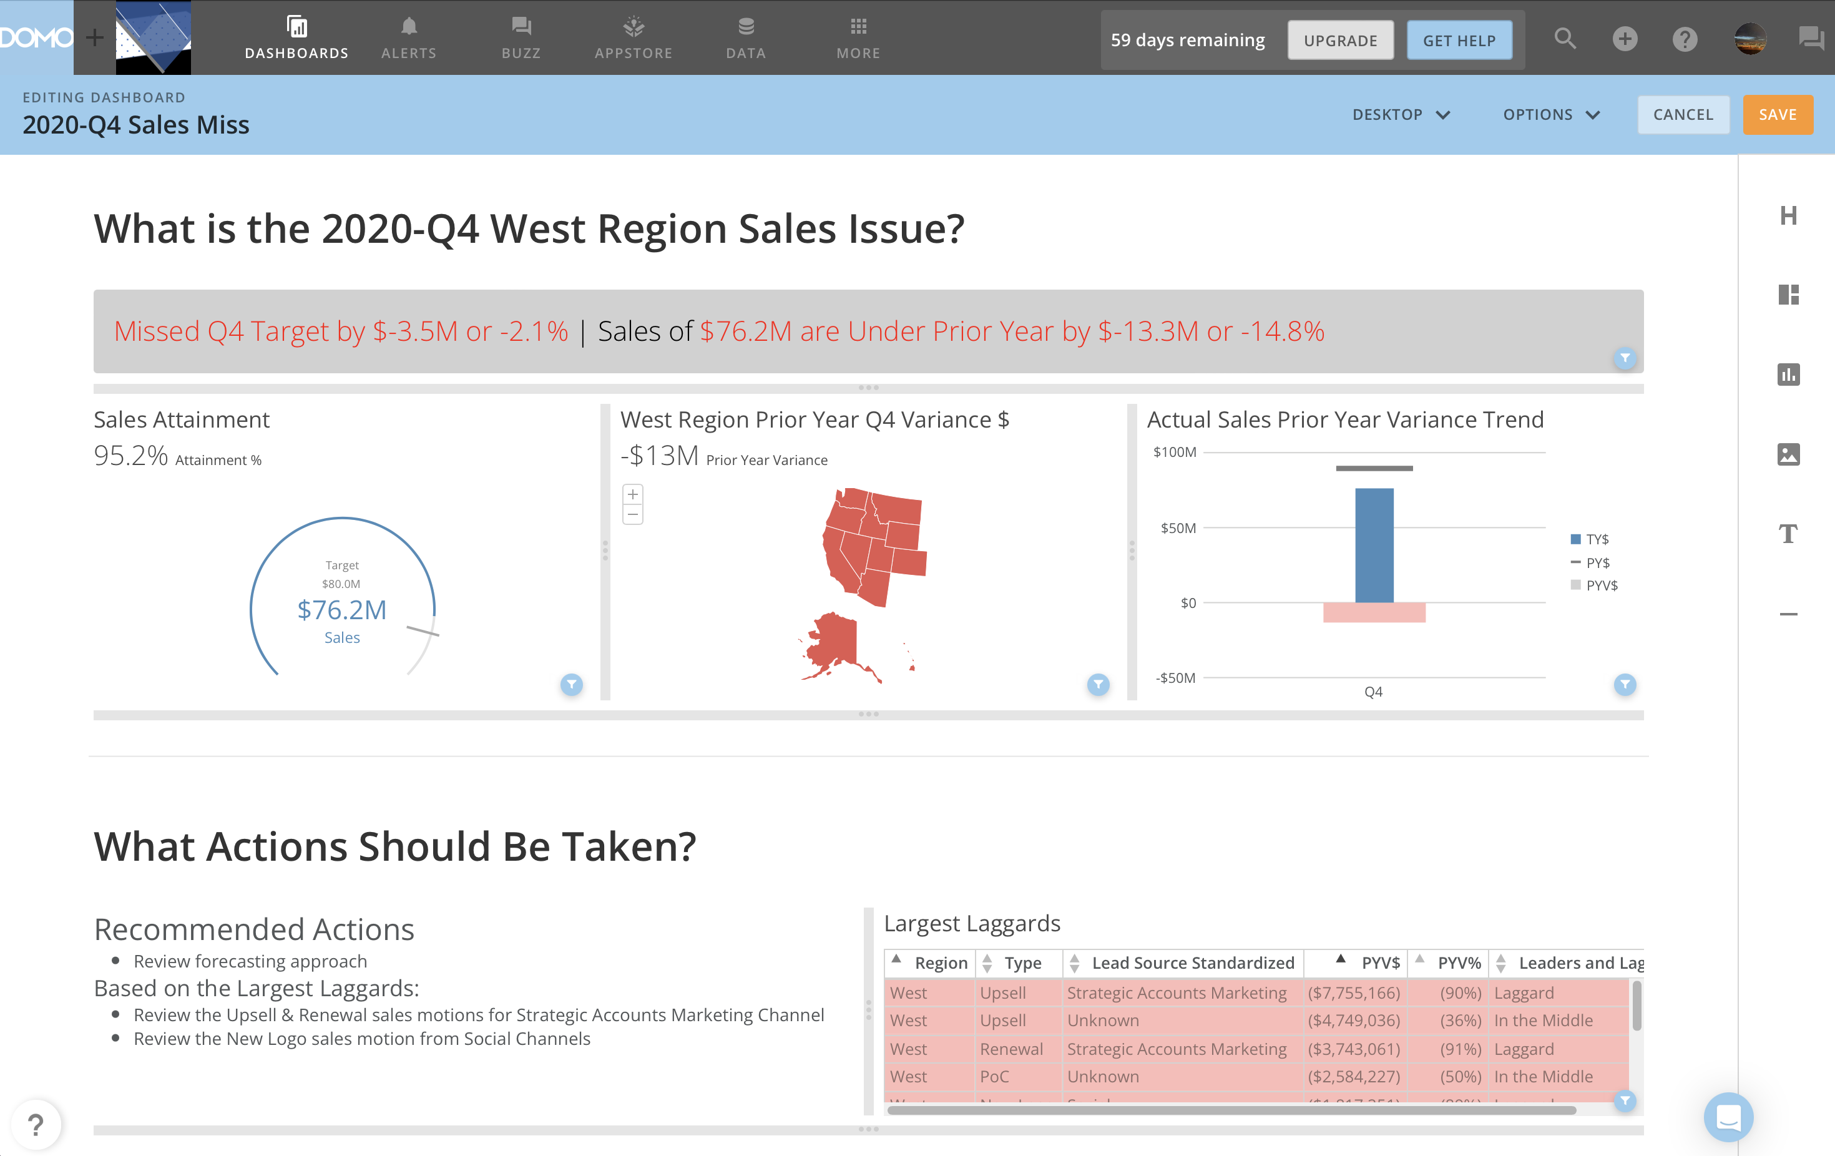

Slide 34
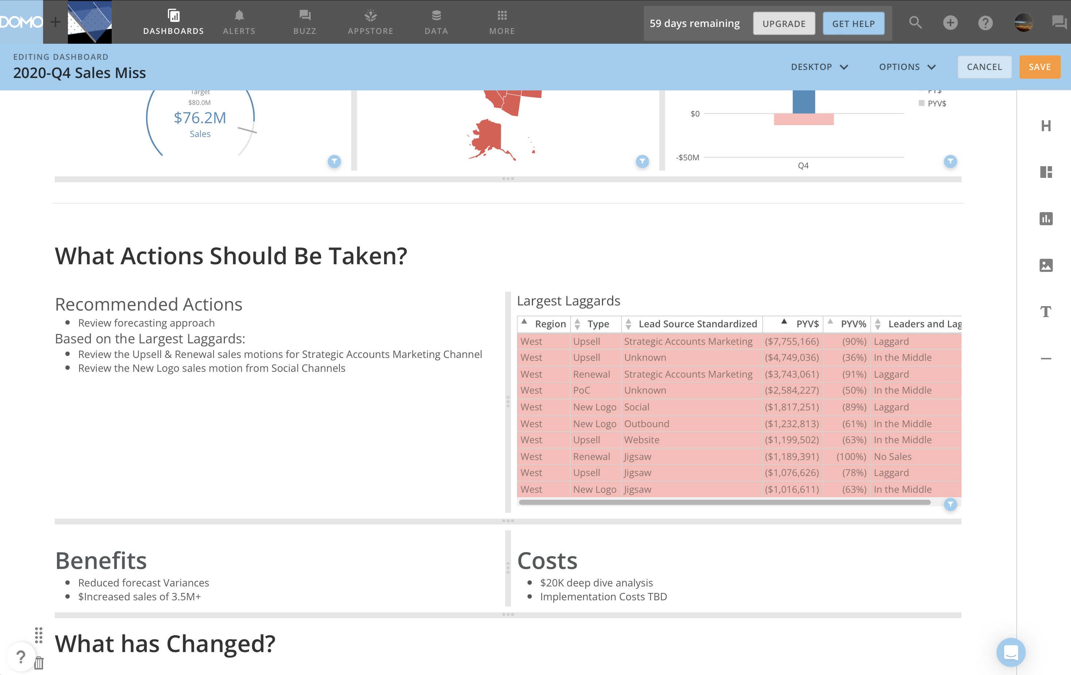

Slide 35
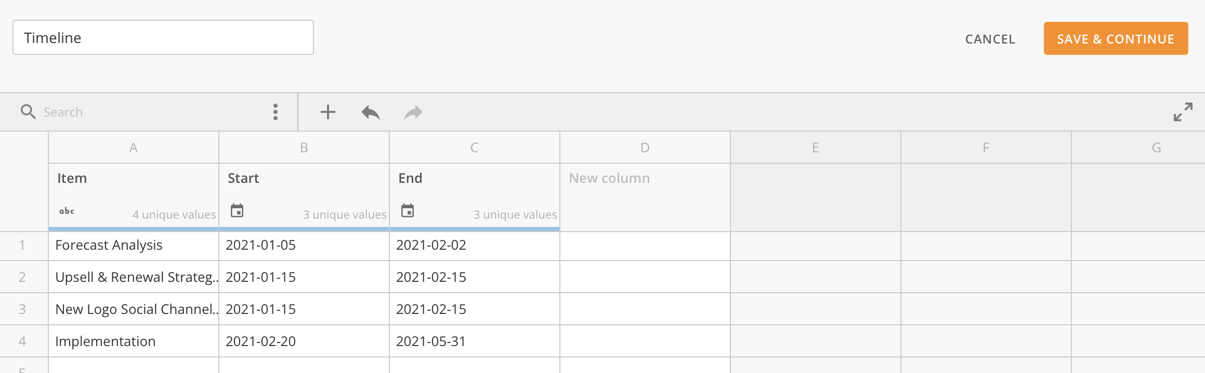

Slide 36
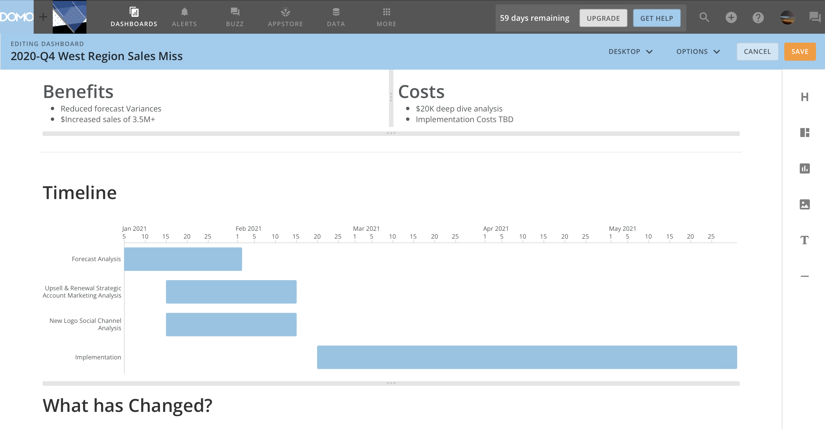

Slide 37
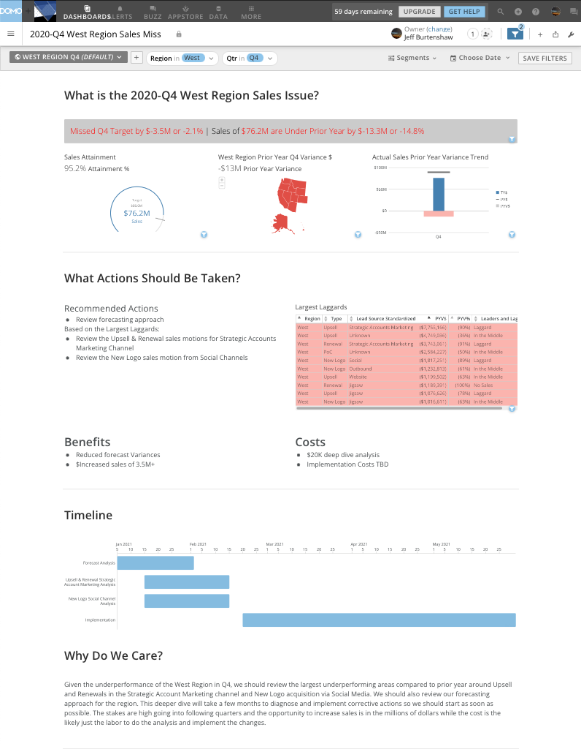

Slide 38
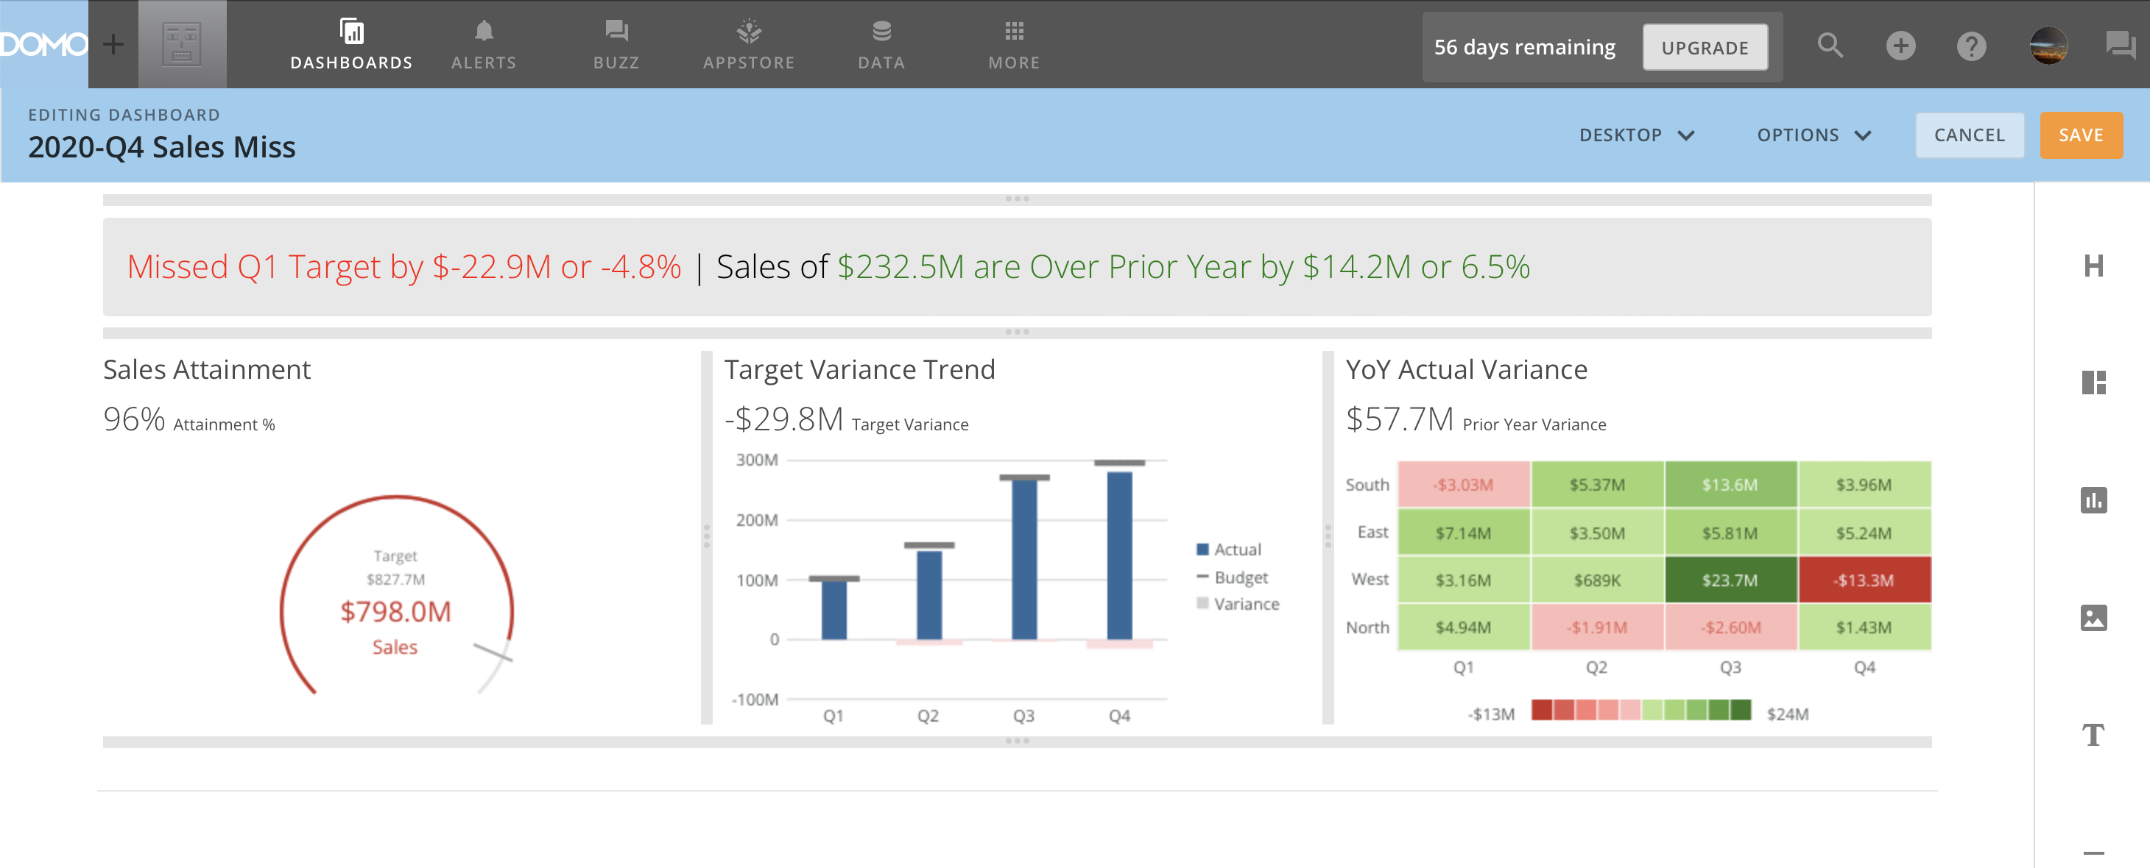

Slide 39
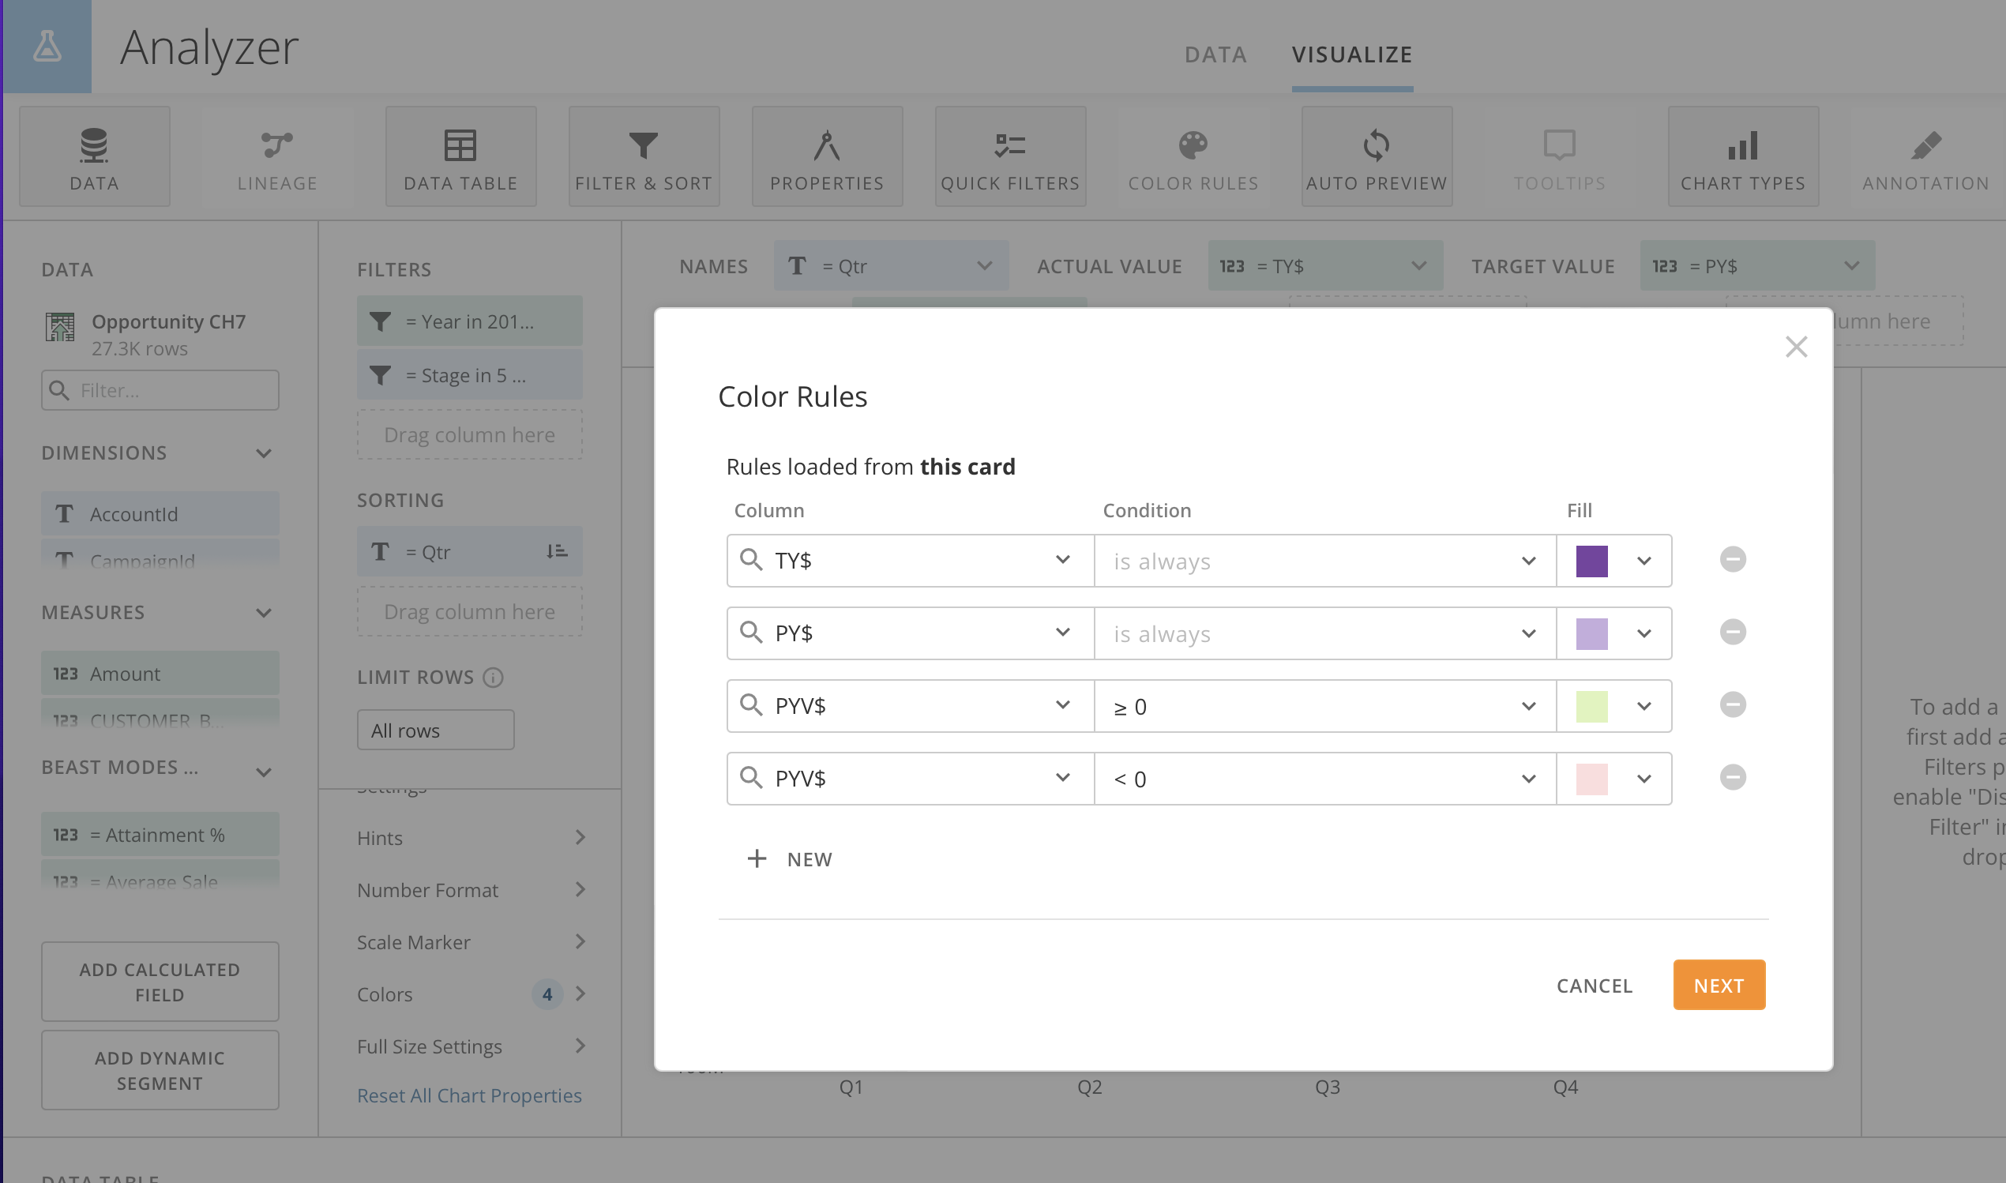

Slide 40
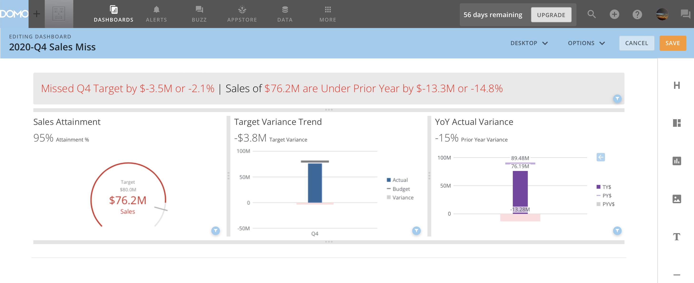

Slide 41
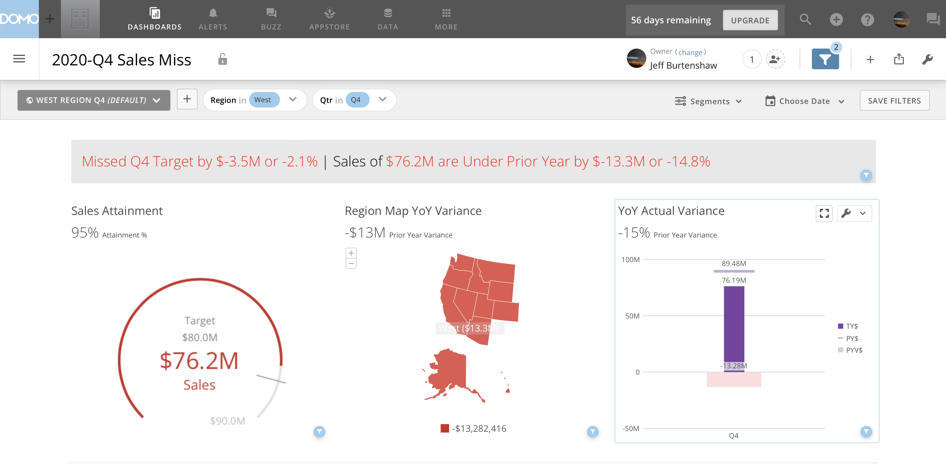

Slide 42
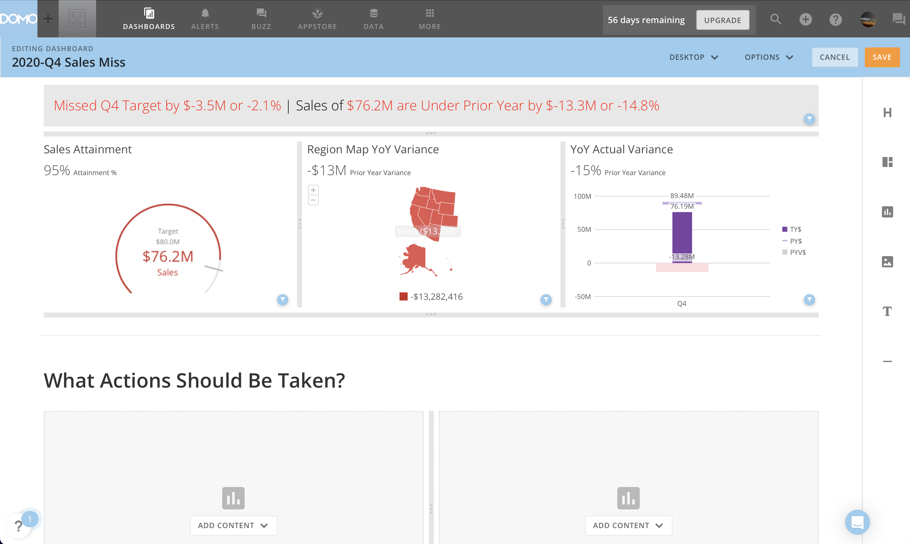

Slide 43
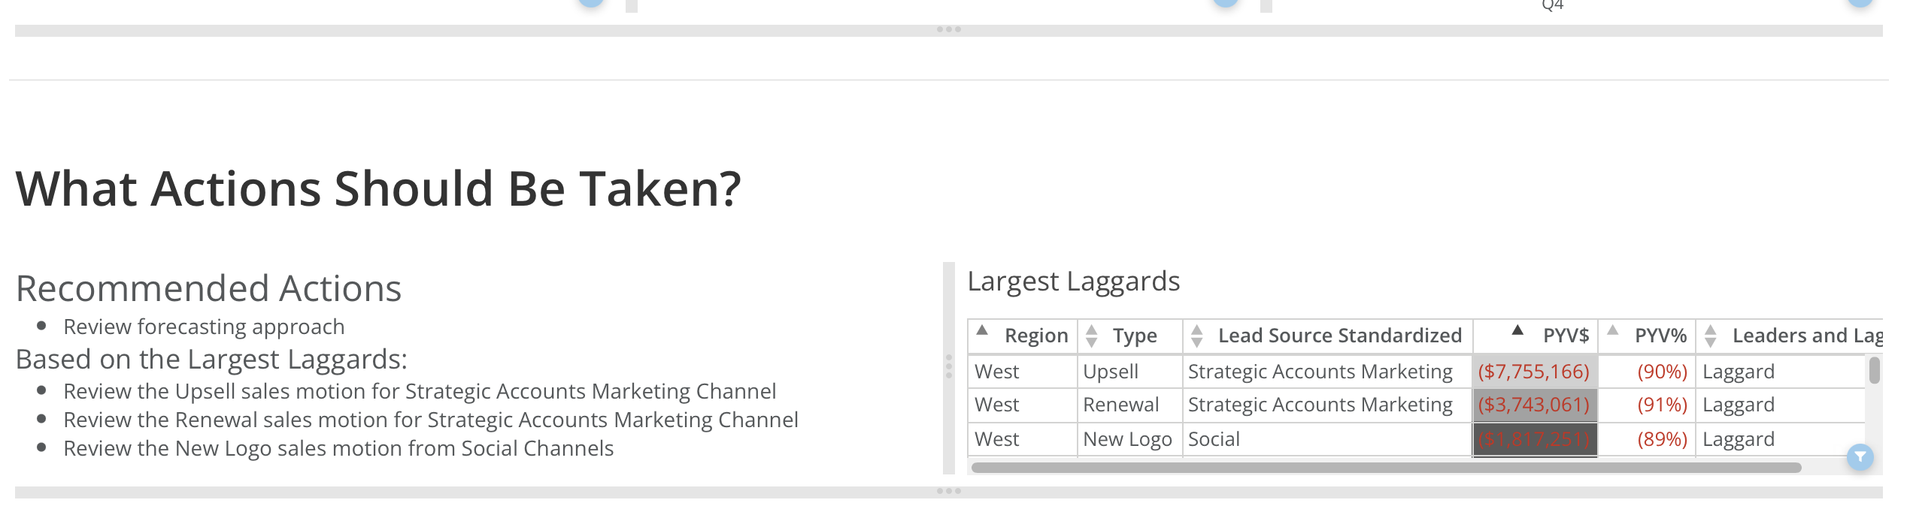

Slide 44
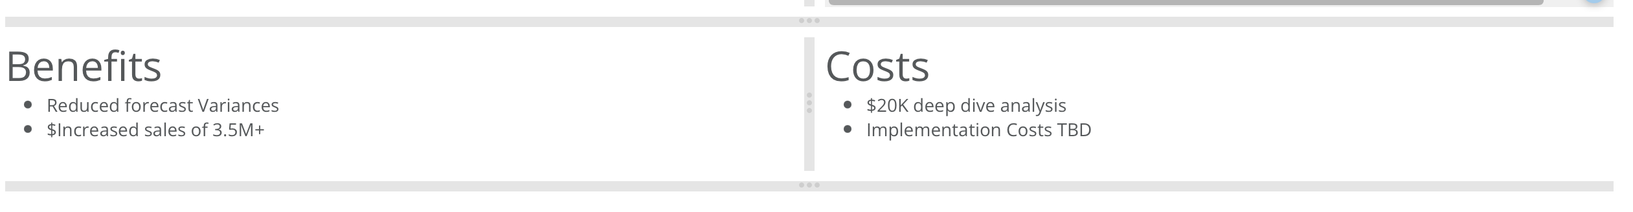

Slide 45
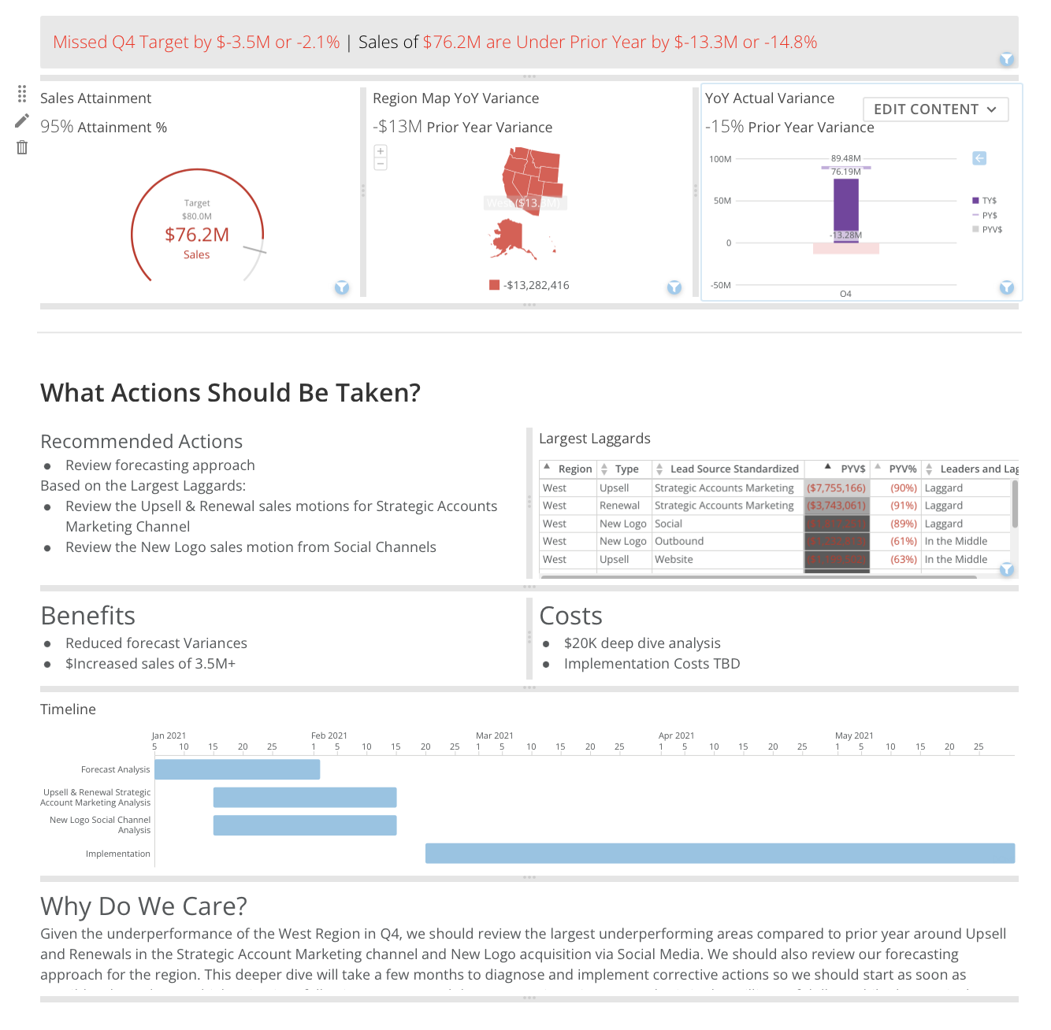

Slide 46
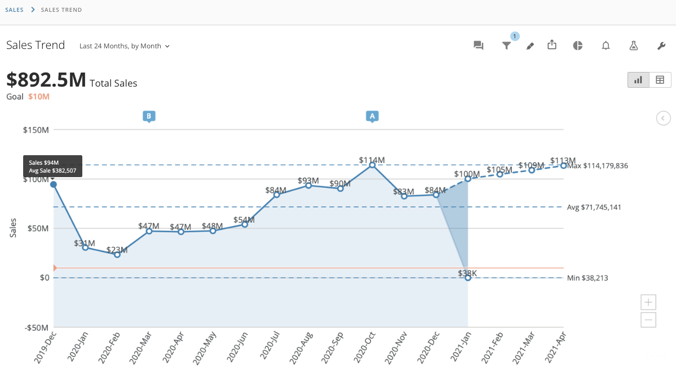
1

Slide 47
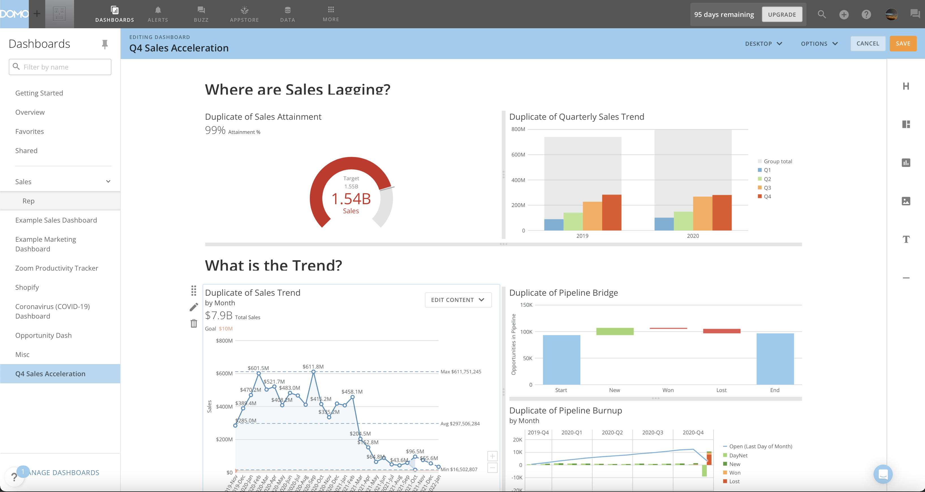
Design Pallet
Header
Layout
Vertical Size Bar
Card
Image
Text
Horizontal Size Bar
Border
Layout Handle
Change Layout
Remove Layout

Slide 48




Notes:
#565555

Slide 49






Slide 50




Slide 51



Slide 52
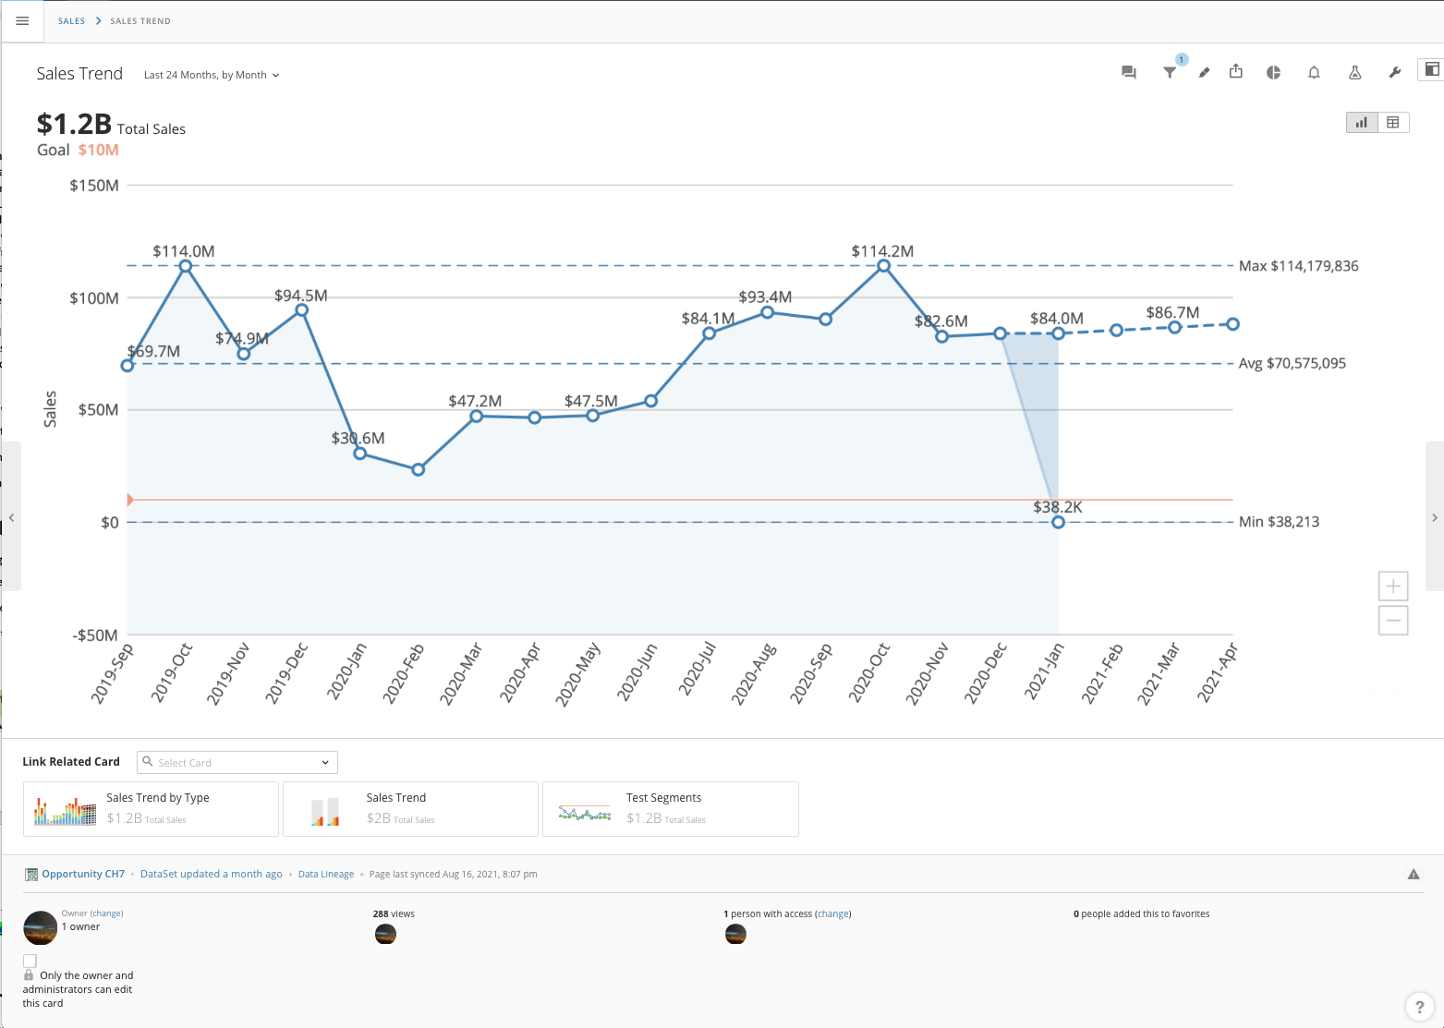

Date Range
Hide/Show Filter Bar
Change Chart Type
Show Quick Filter
Annotate
Table View
Sort
View Prior Card
View Next Card
Links to Related Cards
Adjust Estimated Periods
Range Zoom
Dataset Link
Page Refreshed
Report Issue to Owner
Card Owner
Card Lock
Who Has Viewed
Who Has Access
Who Has Favorited
Dataset Last Update &
Data Update Link
Data Lineage Link

